Slide 1
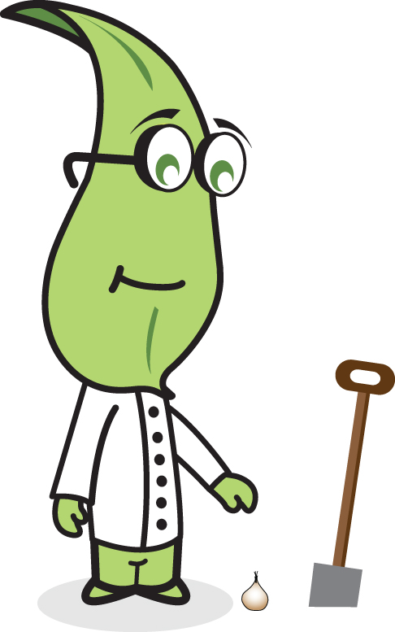

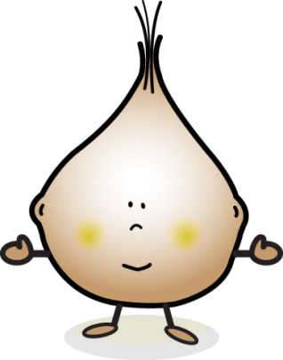



Planting Your Bulbs

Slide 2

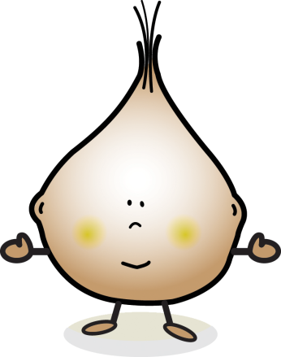
A letter from Professor Plant
Hi Bulb Buddies!
  Congratulations on passing the last task and adopting your new bulbs and bulb plot!
  Now you are ready for the next task –
  Planting your bulbs!
  Please plant your bulbs on planting day if you can!
  Check your resources and our website to find out when planting day is.
  https://museum.wales/learn/spring-bulbs-for-schools/
  Remember to always care for your bulbs and plot as you have promised in your adoption certificate.

Slide 3

What you will need…
The following will be delivered to your school:
One daffodil and one crocus bulb per pupil
Twenty additional daffodil bulbs to plant in the ground
Mystery bulbs (quantity varies each year)
Thermometer
Rain gauge
Trowel
Plant labels and pen
Additionally:
Rulers for measuring bulb depth and spacing.
Stickers or something to mark the front of the plant pot.
You will also need compost, which can be purchased using the One4All voucher.

Slide 4

Health & Safety!
Think of any accidents that could happen while you’re planting.
Then decide on a set of safety rules.

Slide 5
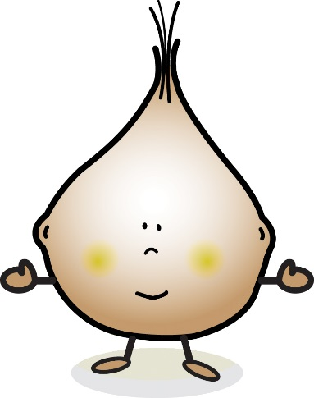
Remember your bulbs are alive - hold them gently!
Take your time to plant your bulbs properly. Relax and enjoy it!
Read through the following advice on planting just before you actually plant your bulbs. Follow the instructions carefully to ensure a fair test.
Good luck with this task!

Slide 6
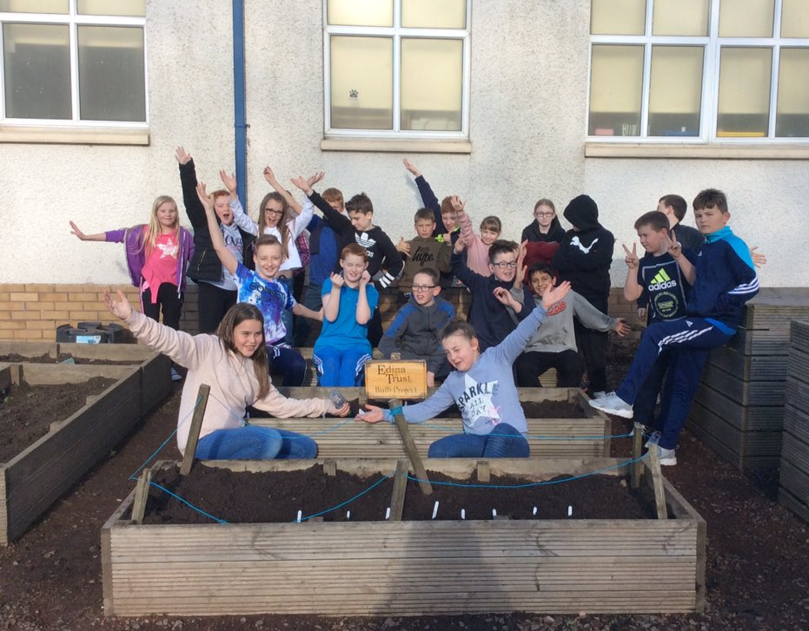
Planting your bulbs in pots and in the ground
You will receive one daffodil bulb and one crocus bulb per participant.
Everyone should plant their own bulbs in a pot.
In addition, you will receive 20 extra daffodils to plant in the ground
We want to compare the growth of daffodils in pots and daffodils in the ground.
You can also plant these 20 bulbs in a planter or a raised bed.

Slide 7

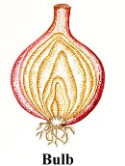
How to plant your bulbs in a pot
Fill your pot with 4cm of multi-purpose compost and push it down firmly. Mark the front of your pot with a small dot – to help you remember which bulb was planted where.
2) Place your Daffodil bulb on the compost, the correct way up - with the roots at the bottom. Put it on the left side when the dot is facing you.

Slide 8

How to plant your bulbs in a pot
3) Sprinkle soil around your bulb until it is half covered, then place your crocus bulb on the soil. Make sure there is space between the bulbs. Put it on the right side when the dot is facing you.
4) Sprinkle compost over the bulbs and firm it with your fingertips.

Slide 9


How to plant your bulbs in a pot
5) Fill up with compost to the top.
6) Water well, then top-up with compost if necessary.
Send your stories and pictures to our bulb-blog and follow Professor Plant on Twitter! www.twitter.com/Professor_Plant

Slide 10


How to plant your bulbs in a pot
7) Once you have finished, check that you have planted your bulbs correctly then add your plant labels to your pot, as shown, so you know which side has the daffodil and which has a crocus.
Remember to wash your hands after planting!

Slide 11
Planting your mystery bulbs…
The type of mystery bulbs will be different each year.
Please plant the mystery bulbs in a separate plant pot.
See if you can guess what they are as they grow!
You can send your guesses to us by email or on Twitter.
?

Slide 12



How to plant your bulbs in the ground
Bulbs should be planted 15cm apart so first work out how you are going to arrange the bulbs in your plot
You could plant them like this:
Or this:
15cm
It’s up to you!

Slide 13
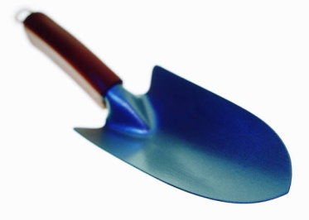


How to plant your bulbs in the ground
Once you have decided how you want to arrange your bulbs, mark out your bulb plot using a ruler and trowel to make a small hole where each of the bulbs are to be planted.
Using the trowel then dig a narrow hole 20cm deep where marked for each bulb
Place a bulb at the bottom of the hole, making sure it has its pointy end facing upwards and it’s roots facing down
20cm

Slide 14
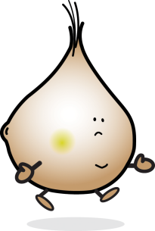
Sprinkle soil over the bulb until it is covered then press it down gently with your fingers
Fill up the hole to the top
Place a numbered label or lolly stick in the soil so you can remember where each bulb is planted
Repeat this for each bulb
Water well, then top-up the holes with more soil if necessary
1
2
3

Slide 15
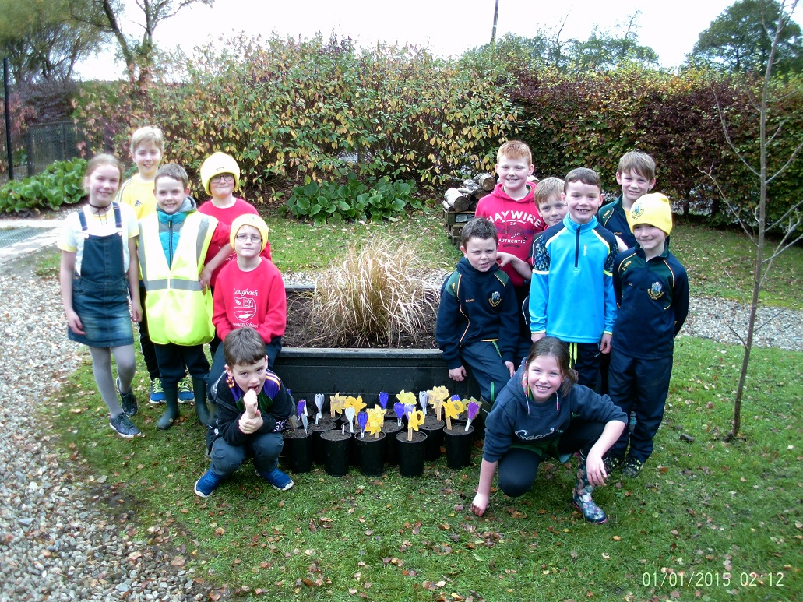
Don’t forget to take a photo of your new daffodil plot for the Planting Day Photo Competition!

Slide 16
Well done Bulb Buddies! Have fun planting your bulbs and watching them grow!
Enter your weather data and find more activities on the Spring Bulbs Website:
https://museum.wales/learn/spring-bulbs-for-schools/

