Slide 1


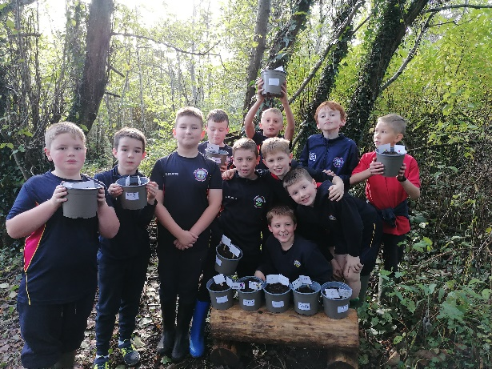
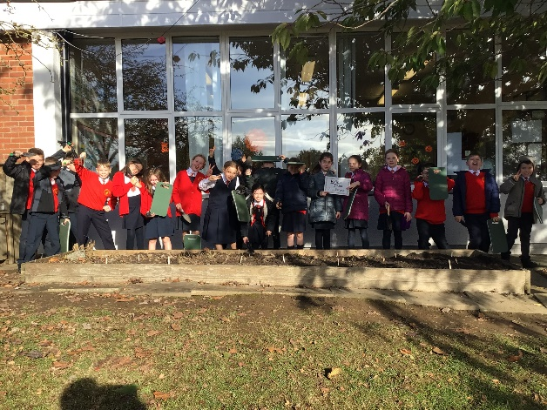
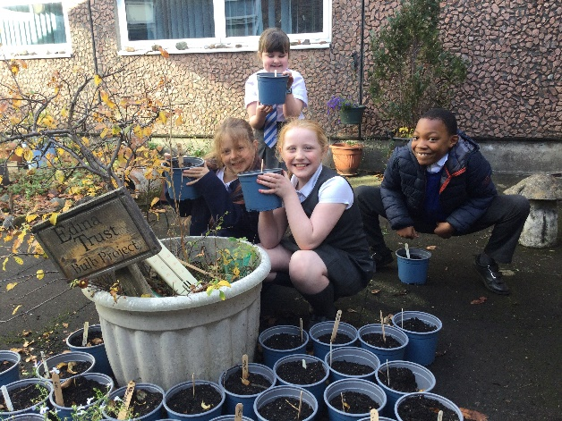
When will our daffodils flower?

Slide 2
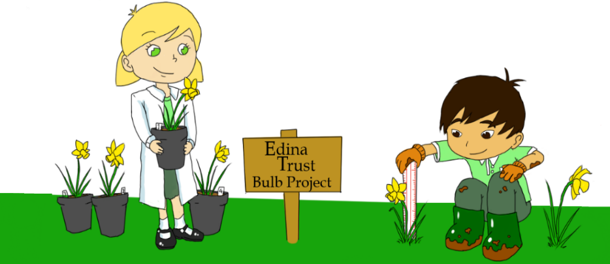
Thank you for sending your data!
We use data that was sent to us by schools on the Bulb Project for our charts and analysis. Thank you for sending us your weather recordings! This is an important part of our investigation.

Slide 3



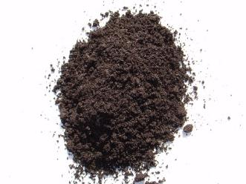


What do plants need to grow?
Can you think of some different things that your bulbs need to be able to grow?
Air
Sunlight
Water
Soil for
Nutrients
Room to grow
Warmth

Slide 4
What do plants need to grow?
Using your rain gauge and thermometer, which of these are you measuring in the Bulb Project?
Air
Sunlight
Water
Soil for
Nutrients
Room to grow
Warmth

Slide 5

Rainfall
Your rain gauge is used to measure the amount of rainfall – the amount of water your bulbs are getting.
How can you work out the total amount of rainfall at your school for one month?
Add all your rainfall records together for January and write down your answers for later.

Slide 6
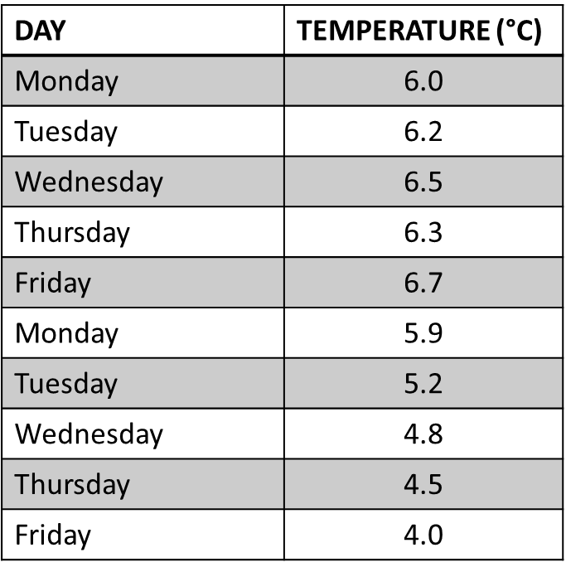
Temperature
For example…
1
2
The daily weather recordings include the temperature from your thermometer.
How could you work out the average (mean) temperature for January at your school?
3
4
5
6
7
1. Add together all the temperatures you recorded in January.
8
9
10
2. Divide the sum by the number of days for which you have weather records in January. Write down your answer for later.
Total = 56.1
First, add up all these temperatures
Then divide by the number of days.
56.1 ÷ 10 = 5.6

Slide 7
Rainfall Across the UK
This bar chart shows the total amount of rain per school in November for the four countries taking part in the Bulb Project.

Slide 8
Rainfall Across the UK
48mm
38mm
34mm
25mm
Wales recorded
the most rain in November!
Northern Ireland recorded the least rain.
1. Which country had the most rain in November?
2. Which country had the least rain?

Slide 9
Rainfall Across the UK
This bar chart shows the total amount of rain per school in December for the four countries taking part in the Bulb Project.

Slide 10
Rainfall Across the UK
62mm
41mm
Wales recorded
the most rain in December!
35mm
25mm
1. Which country had the most rain in December?
2. Do you think the school holiday could have an impact on the total amount of rain schools record?

Slide 11
Rainfall Across the UK
This bar chart shows the total amount of rain per school in January for the four countries taking part in the Bulb Project.

Slide 12
Rainfall Across the UK
41mm
38mm
26mm
13mm
Northern Ireland recorded
the most rain in January
1. Which country had the most rain in January?
2. How much rain did your school record in January? Was it higher or lower than the amount shown here?

Slide 13
Temperature across the UK
This line graph shows the average (mean) temperature in November, December, and January.

Slide 14
Temperature across the UK
Wales had the highest temperature in November.
Scotland had the coldest temperature in November.
Which country had the warmest weather in November?
Which country had the coldest weather in November?

Slide 15
Temperature across the UK
England had the highest temperature in December.
Northern Ireland had the lowest temperature in December.
Which country had the warmest weather in December?
Which country had the coldest weather in December?

Slide 16
Temperature across the UK
Wales had the highest temperature in January.
Scotland had the lowest temperature in January.
Which country had the warmest and coldest weather in January?
How does your average temperature for January compare to the temperatures shown on the chart?

Slide 17

Making a hypothesis
A hypothesis is the starting point for a science experiment or investigation. It is a prediction or idea that has not yet been proven, but is based on facts.
Use these questions to create your hypothesis:
Based on the rainfall and temperature, which country do you think daffodils will flower in first?
Why do you think so?
See the next slide for more details!

Slide 18


Making a hypothesis
November 2025 – January 2026 | Total Rainfall (mm) | Average Temperature (°C)
Scotland | 87 | 5.9
England | 101 | 5.8
Northern Ireland | 92 | 7.1
Wales | 148 | 7.3
Dry!
Colder
Warmer
Wet!
Fill in the blanks in the sentence below to make your own hypothesis:
“I think that daffodils will flower first in ________
because ____________________________________.”

Slide 19
More to think about…
Compare the total rainfall and average temperature for your school with the data below.
Do you think your school’s daffodils will flower earlier or later than other schools in your country? Why do you think so?
November 2025 – January 2026 | Total Rainfall (mm) | Average Temperature (°C)
Scotland | 87 | 5.9
England | 101 | 5.8
Northern Ireland | 92 | 7.1
Wales | 148 | 7.3
Dry!
Colder
Warmer
Wet!
If your prediction doesn’t end up being correct, can you think of a reason why?

Slide 20
Compare the weather
to the last two years
This table shows the weather data for November – January for the last three years of the Bulb Project, across all four countries.
 | 2023-2024 | 2024-2025 | 2025-2026
UK Total Rainfall Nov-Jan | 305mm | 196mm | 428mm
UK Average Temperature | 7.0°C | 6.5°C | 7.3°C
2025/26 had the most rain.
The temperature was highest in 2025/26.
Which year had the most rain?
Which year had the higher temperature?

Slide 21
Compare the weather
to the last two years
 | 2023-2024 | 2024-2025 | 2025-2026
UK Total Rainfall Nov-Jan | 305mm | 196mm | 428mm
UK Average Temperature | 7.0°C | 6.5°C | 7.3°C
UK Average Flowering Date | 4th March | 7th March | ?
Have your bulbs flowered yet?
Do you think the average flowering date will be earlier or later than 7th March this year?
Fill in the blanks in the sentence below to make your own hypothesis:
“I think that, on average, daffodils will flower _______ this year because ____________________________________.”

Slide 22
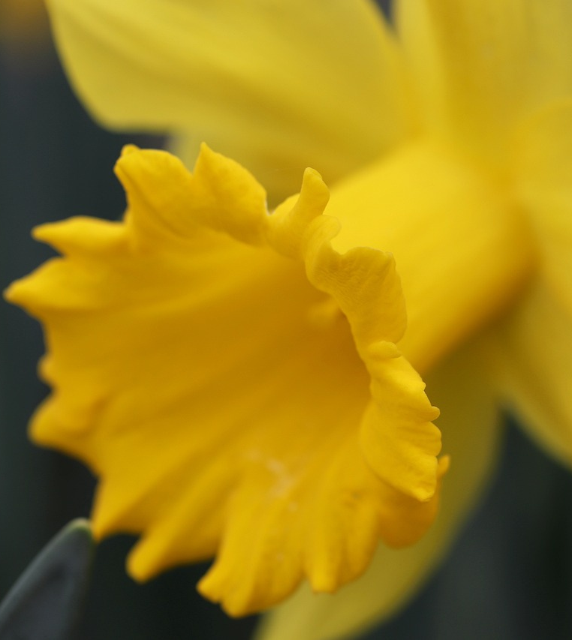
And now we wait…
Now you have some hypotheses for your investigation!
We will have to wait and see if they are correct, as this is a real, ongoing investigation.
Don’t worry if your predictions turn out to be wrong – real scientists can find their predictions are wrong too and must rethink their ideas. That is how we make new discoveries!

Slide 23
Further Discussion: What can schools do to make the Bulb Project a fair test?
Air
Sunlight
Water
Soil for
Nutrients
Room to grow
Warmth
Remember: to be a fair test, only the factors we are measuring should change (water and temperature). Everything else should stay the same, even at different schools.

Slide 24
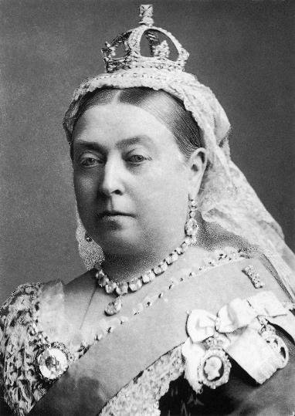
Further Discussion
You can look at the weather reports from the Met Office online. What trends can you see when looking at the data over a longer period of time?
Click here to find the charts!
The MET Office records go all the way back to 1884 for temperature and 1862 for rainfall.
That was during Queen Victoria’s reign!

Slide 25
Further Discussion: Why might our data be different to the Met Office data?
We use data sent by schools to make our charts and compare with previous years.
The Met Office uses data sent by more than 200 automatic weather stations around the UK.
You can find a map of these weather stations, and even submit your own observations, here: https://wow.metoffice.gov.uk/

Slide 26
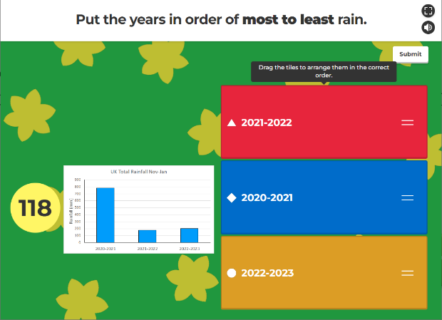

Further Activities…
Take part in our Kahoot Challenge and share your prediction about when your daffodils will flower. This is a quiz you can complete online.
Click to open in your web browser

Slide 27

Don’t miss out on these FREE virtual workshops!
Climate Clues: From the Past to Our Future - 4th March 2026
Contribute to Change: Pledge for the Planet - 11th March 2026
Book your ticket on the Spring Bulbs website.

Slide 28
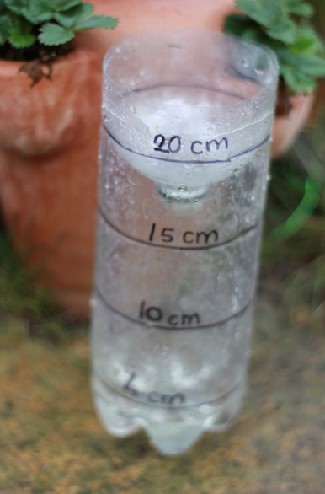

Further Activities…
You can find hands-on weather and gardening activities on the National Museum Wales website:
Click here to take a look!

Slide 29
Thank you for taking part in the Bulb Project!
We look forward to learning when your spring bulbs flower.
Don’t forget to submit your flowering dates online: https://museum.wales/spring-bulbs/

