Slide 1



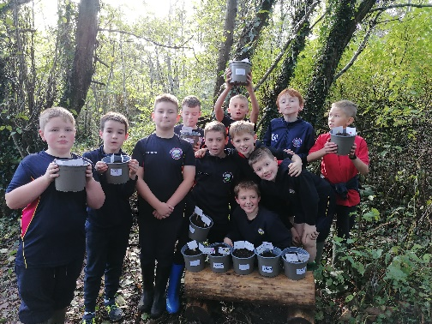
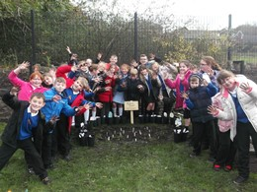
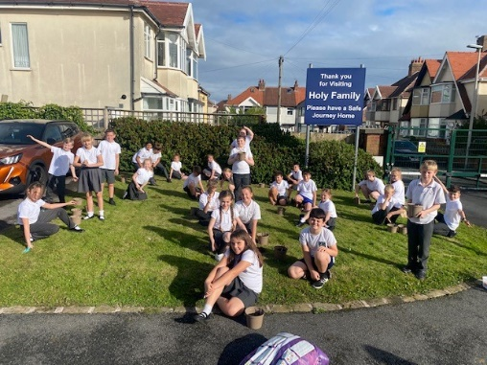
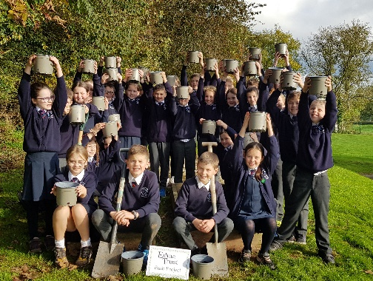

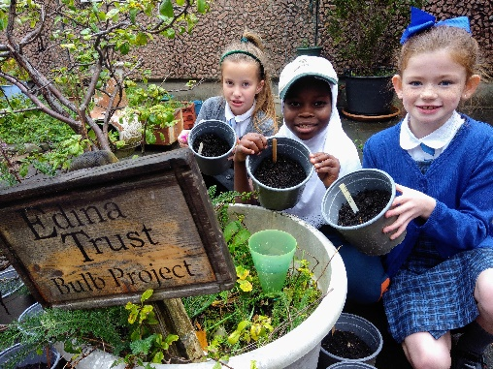
Results Report
2023

Slide 2


The Edina Trust would like to thank everyone that worked so hard planting their bulbs, observing, and sending in their records.
We couldn’t have carried out an experiment like this without your help! You are all SUPER!
And now for the results…
Look out for questions along the way!
?

Slide 3
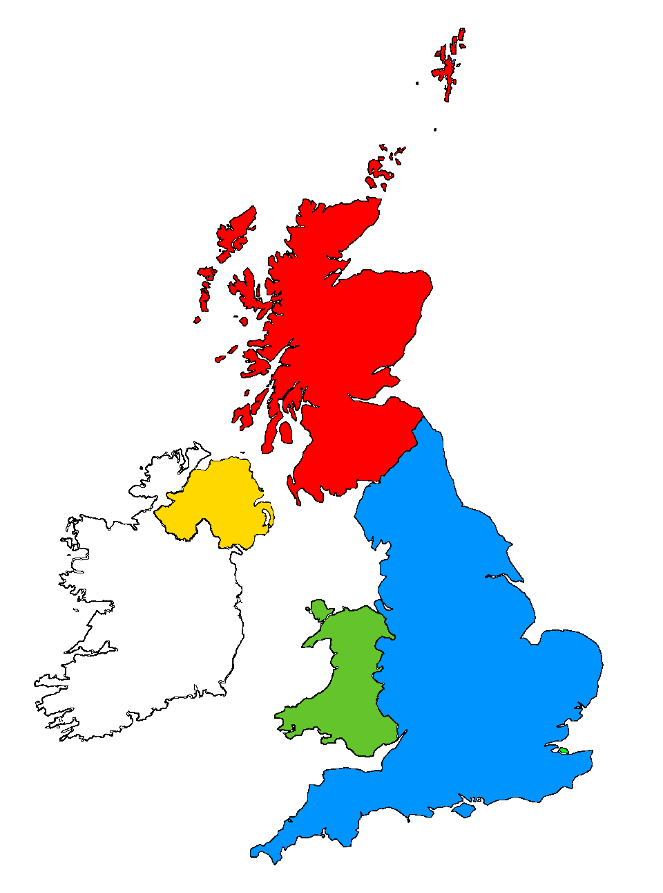
For this investigation we divided all schools into the four countries taking part:
Scotland
England
Northern Ireland
Wales

Slide 4


?
Which country had the most rain?
470mm
310mm
295mm
288mm
During the Bulb Project, Wales had an average of 182mm more rain than Northern Ireland.
Wales had the most rain during the project this year.
Can you estimate how much more rainfall there was in Wales compared to Northern Ireland?
?

Slide 5

?
Which country was the warmest/coldest?
Scotland is further north (it has a higher latitude). Places further from the equator do not have as much direct sunlight so it is normally colder.
Click here to watch the animation!
or click outside this box to skip
Wales was warmest this time, and Scotland was the coldest
?
Why do you think Scotland was colder than the rest of the UK?

Slide 7
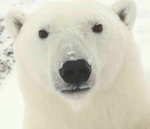
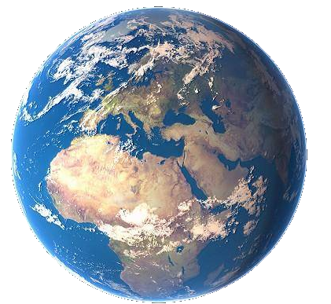
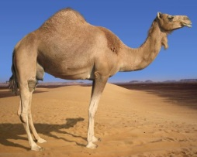

As the sunlight is shining on the Earth…
UK
This makes it warm at the equator and cold at the North and South Pole!
Equator
…the same amount of light and warmth is spread across more of the surface than at the equator.
Click here to replay!
or click outside this box to move on.

Slide 8

Which country was the coldest
in December?
?
Scotland was the coldest country in December.

Slide 9
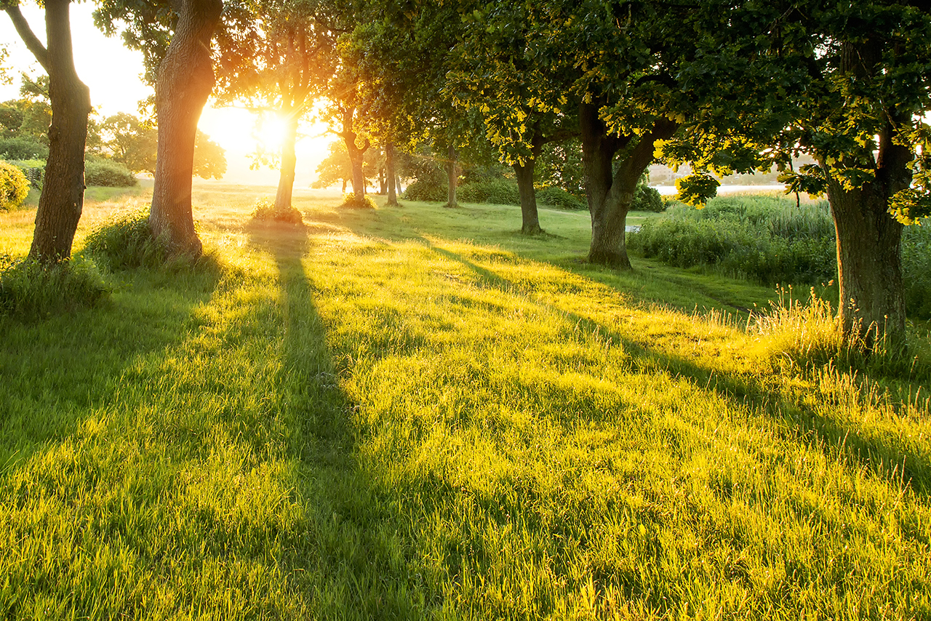
Which country was the warmest
in March?
?
Wales was the warmest country in March.

Slide 10
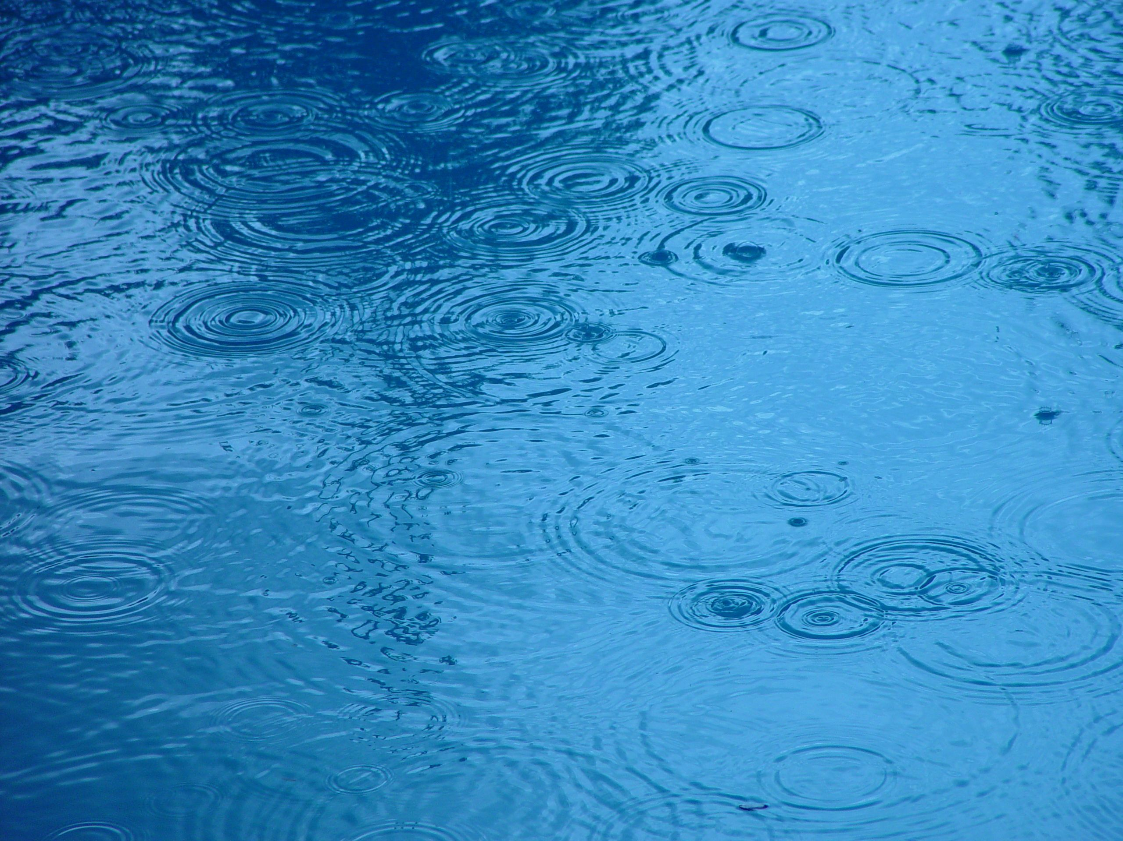

?
Considering what we know so far, where do you think daffodils flowered first?
2022-23 Weather Data from Schools
Most Rain: Wales Scotland, England, and Northern Ireland had similar amounts of rain. Northern Ireland was the driest by a little bit! | Warmest: Wales England and Northern Ireland were almost the same temperature. Scotland was the coldest.

Slide 11






Not yet edited for 2022/23
Plants require water and warm sunlight to grow, so daffodils grew more quickly where they had plenty of both.
However they can sometimes have too much water or sun, so this won’t always be true!
?
Where did the first daffodils flower?
1. Scotland – 10th March
5
8
1
2
23
16
14
13
24
11
3
6
20
7
4
22
Click to start the animation and find out!
9
19
21
2. England – 22nd March
15
10
17
12
18
3. N. Ireland – 22nd March
4. Wales– 24th March
Note: These are the average dates for bulbs in pots AND bulbs in the ground.
March
March
March
March
March
March
March
March
March
March
March
March
March
March
March
March
March
March
March
March
March
March
March
March
Daffodils flowered first in Scotland this year!
Were you correct? Why do you think that is?
?

Slide 12

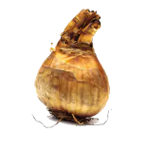
Our hypothesis for the Bulb Project is that daffodils in pots will flower before those in the ground.
We think this is because bulbs in the ground are more insulated, so they do not “feel” the changes in temperature as much.
The weather is freezing today!
Let’s find out what happened, using the data sent by our Super Scientists… (You!)
We’re plenty warm down here!

Slide 13






How many days difference was there between the daffodil flowering dates?
?
= bulbs planted in the ground
= bulbs planted in pots
?
?
?
?
2
8
Wales
0
days difference
Scotland
8
N. Ireland
England
March
M | T | W | T | F | S | S
 | 1 | 2 | 3 | 4 | 5 | 6
7 | 8 | 9 | 10 | 11 | 12 | 13
14 | 15 | 16 | 17 | 18 | 19 | 20
21 | 22 | 23 | 24 | 25 | 26 | 27
28 | 29 | 30 | 31
Average Flowering Date for Each Country

Slide 14
Here are the average flowering dates across the whole of the UK compared to last year:
 | 2022 | 2023
Daffodils in Pots | 12th March | 24th March
Daffodils in the Ground | 5th March | 23rd March
The average flowering date for daffodils planted in pots was later than in 2023. The flowering date for daffodils planted in the ground had an even bigger difference!
In fact, daffodils flowered so late on average this year that this could have affected the results...

Slide 15
Spring Bulbs flowered late this year…
A lot of schools reported that their daffodils didn’t flower or didn’t grow at all.
 | Spring 2023 | Spring 2022
Number of bulbs reported as ‘Did not flower’ | 466 | 92
Thank you to everyone who reported their flowering dates or that their bulbs didn’t flower - both cases are important for our investigation!
Because of this, the low sample size of the data (especially in Scotland) could have affected the results.
 | Bulbs Planted | Flowering Dates
Scotland | 1,963 | 34
England | 2,495 | 116
N Ireland | 1,559 | 104
Wales | 229 | 197*
This includes all participating schools in Wales, not only schools on the Edina extension project.

Slide 16
Our hypothesis was not supported by the data this year. Daffodils in pots flowered first, but only by one day.
Even though we were “wrong”, this is very important data. Now we need to think about why our hypothesis was not supported.
Do you have any ideas?
?

Slide 17
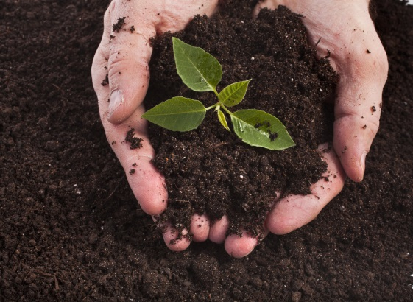
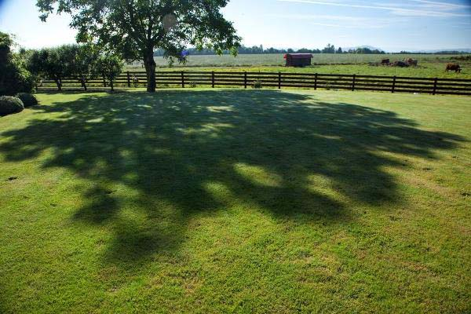
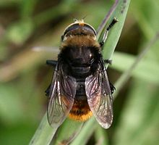
?
Do you think there could be other reasons for bulbs to flower earlier or later?
I’m not a bee! I’m a Narcissus Fly and I eat daffodil bulbs. I look like a bee to make other animals think I can sting!
Here are some ideas of things that might affect daffodil flowering dates…
Soil quality
Shade
Pests & diseases
?
What changes could you make to the Bulb Project to test these ideas?

Slide 18

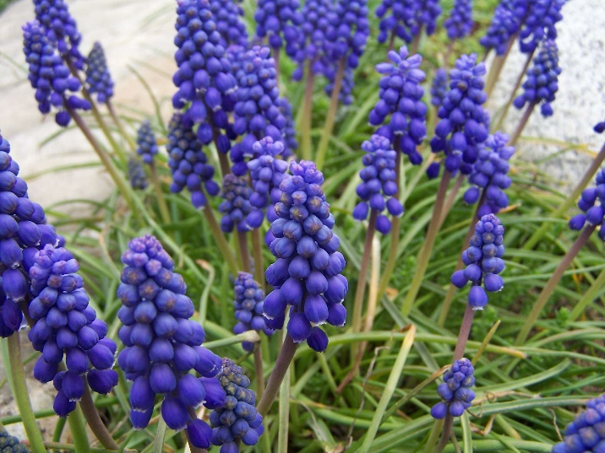
Mystery Bulbs!
Have your mystery bulbs flowered yet?
You can click the box to see a photo of the same type of flower!
(You can click elsewhere to skip if yours haven’t flowered and you don’t want the surprise to be spoiled!)
Click Here
to reveal the mystery bulb flowers!
?
Can you find out what kind of flower this is?
Have you seen any growing in gardens or parks near your home?
Click here to reveal the answer!
These are grape hyacinths (Muscari armeniacum)
?

Slide 19
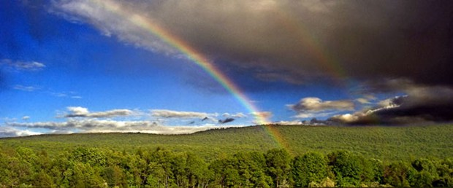
Finding a trend is quite difficult but some things are clear…
The bulbs rely on both warm sunshine and water in order to flower.
Our seasons are becoming more unpredictable as our world is getting warmer.
How do you think this will affect the growth of plants in the future?
?

