Slide 1



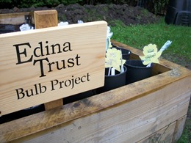
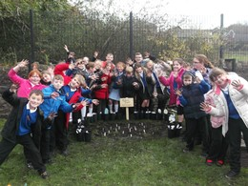
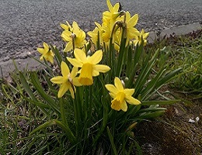
Results Report

Slide 2


Super Scientists!
The Edina Trust would like to thank everyone that worked so hard planting their bulbs, observing, and sending in their records.
We couldn’t have carried out an experiment like this without your help!
And now for the results…
Look out for questions along the way!
?

Slide 3
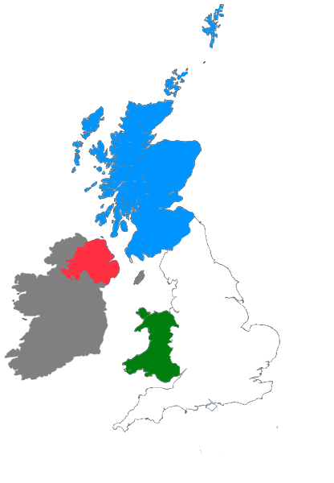
For this investigation we divided the schools that took part into the four countries taking part:
Scotland: Dumfries & Galloway, Dundee, East Ayrshire, Fife, Inverclyde, North Ayrshire, North Lanarkshire, Renfrewshire, South Lanarkshire, West Dunbartonshire
England: Lancashire, Lincolnshire, Middlesbrough, Oxfordshire, Sunderland
Northern Ireland: Belfast, Derry/Londonderry, Strabane
Wales: Conwy, Holywell, Rhondda Cynon Taf

Slide 4


?
Which country had the most rain?
During the Bulb Project, Wales had an average of 70mm more rain per month – nearly double the amount in England!
Wales had the most rain during the project.
Can you estimate how much more daily rainfall there was in Wales than England?
?

Slide 5

?
Which country was the warmest/coldest?
Scotland is further north than England (it has a higher latitude). Places further from the equator do not have as much direct sunlight so it is normally colder.
Click here to watch the animation!
or click outside this box to skip
England was warmest, Scotland was coldest.
Why do you think that is? Why might Scotland have been the coldest area?
?

Slide 7

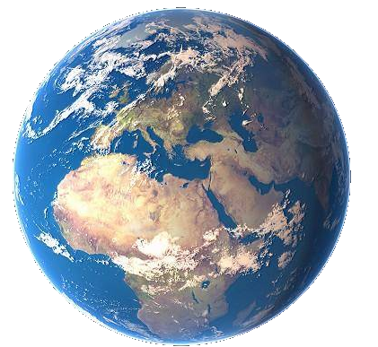
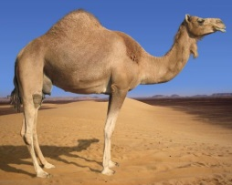

As the sunlight is shining on the Earth…
UK
This makes it warm at the equator and cold at the North and South Pole!
Equator
…the same amount of light and warmth is spread across more of the surface than at the equator.
Click here to replay!
or click outside this box to move on.

Slide 8
?
Which country was the warmest in February?
Northern Ireland was the warmest region in February. England and Wales were very close too, compared to Scotland.

Slide 9
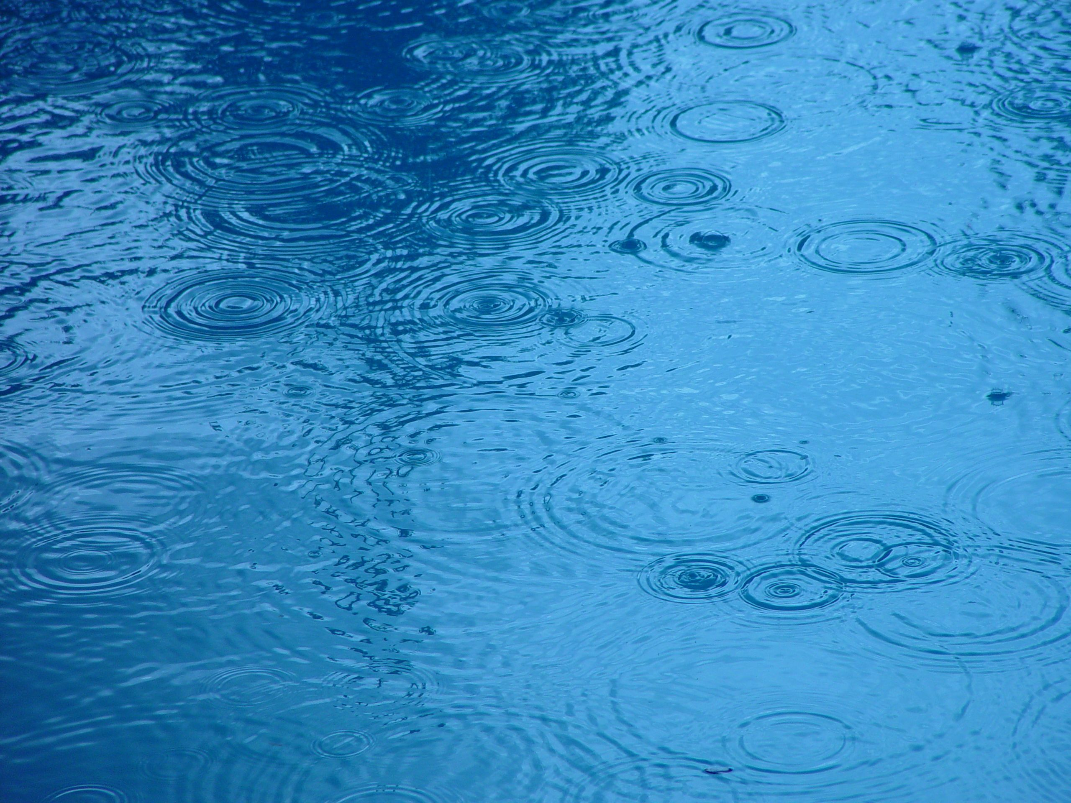

?
Considering what we know so far, where do you think daffodils flowered first?
Most Rain: 1 – Wales 2 – Scotland 3 – Northern Ireland 4 - England | Warmest: 1 – England 2 – Wales 3 - Northern Ireland 4 - Scotland

Slide 10
?
Where did the first daffodils flower?
Plants require water and warm sunlight to grow, so daffodils grew more quickly where they had plenty of both.
However they can sometimes have too much water or sun, so this won’t always be true!
Average Flowering Date for Each Country
Daffodils flowered first in Wales.
Were you correct? Why do you think that is?
?

Slide 11


?
How many days are there between daffodils in the ground and daffodils in pots flowering?
= bulbs planted in the ground
= bulbs planted in pots
6 days
11 days
9 days
14 days
Average Flowering Date for Each Area

Slide 12

We were surprised because our hypothesis (our idea) was that the daffodils in pots would flower first. But we were wrong!
Science is all about questioning why things happen. Now we need to think about why we were wrong.

Slide 13
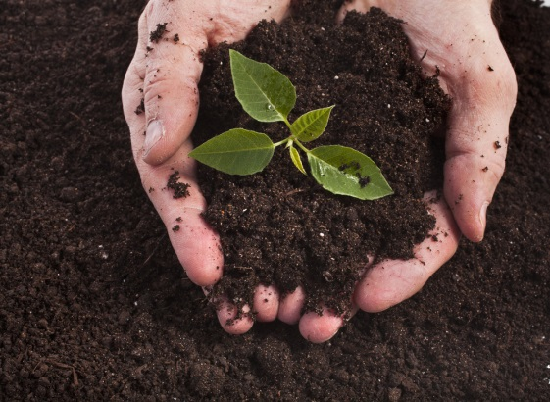
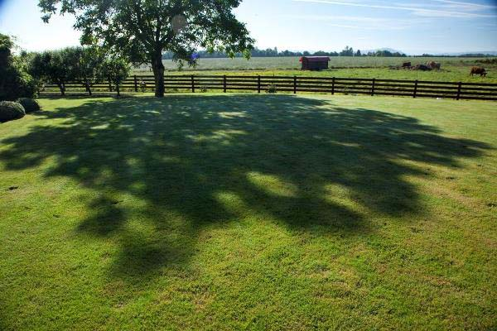
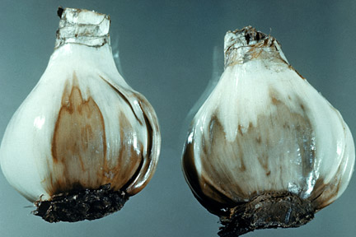
?
Why do you think the daffodils in the ground flowered before the daffodils planted in pots?
Here are some ideas of things that might affect daffodil flowering dates…
Soil quality
Shade
Pests & diseases
?
What changes could you make to the Bulb Project to test these ideas?

Slide 14
Which region had the tallest/shortest daffodils?
?
29cm
28cm
Average Height (cm)
About 6cm difference
26cm
23cm
?
Using the bar chart can you estimate how tall the daffodils are?
How much taller were daffodils in Northern Ireland compared to Scotland?

Slide 15
On average, the daffodils were tallest in Northern Ireland.
This could be because:
Northern Ireland was not the warmest or the wettest area, but perhaps it had just the right conditions for daffodils to grow tall.
To be sure why, we would need to do more experiments.
Can you think of any reasons why daffodils may have grown taller in Northern Ireland?
?

Slide 16
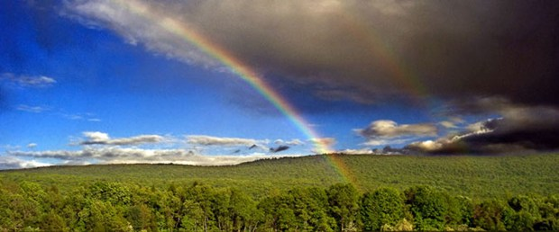
Finding a trend is quite difficult but some things are clear…
The bulbs rely on both warm sunshine and water in order to flower.
Our seasons are becoming more unpredictable as our world is getting warmer.
How do you think this will affect the growth of plants in the future?
?

