Slide 1



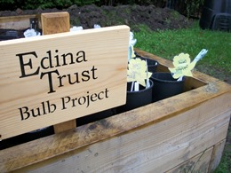
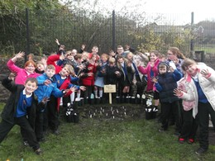
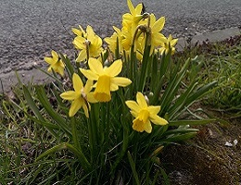
Results Report

Slide 2


Super Scientists!
The Edina Trust would like to thank everyone that worked so hard planting their bulbs, observing, and sending in their records.
We couldn’t have carried out an experiment like this without your help!
And now for the results…
Look out for questions along the way!
?

Slide 3



For this investigation we divided the schools that took part into three regions…
Scotland
including Fife, North Ayrshire, North Lanarkshire, Renfrewshire, South Lanarkshire, West Dunbartonshire
North England
including Lancashire, Middlesbrough, Hartlepool, Sunderland
South England/Wales
including Lincolnshire, Oxfordshire, Conwy, Rhondda Cynon Taf

Slide 4


?
Which region had the most rain?
It was close, but during the Bulb Project there was on average 0.6mm more rain every day in South England/Wales than in Scotland.
South England/Wales had the most rain during the project.
Can you estimate how much more daily rainfall there was in South England/Wales than Scotland?
?

Slide 5

?
Which region was the warmest/coldest?
Scotland is further north than England (it has a higher latitude). Places further from the equator do not have as much direct sunlight so it is normally colder.
Click here to watch the animation!
or click outside this box to skip
South England/Wales was warmest, Scotland was coldest.
Why do you think that is? Why might Scotland have been the coldest area?
?

Slide 7
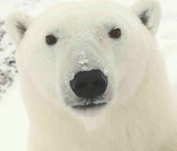
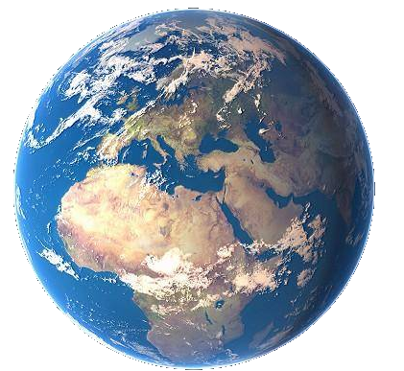
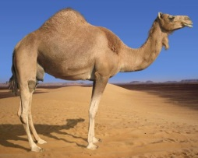

As the sunlight is shining on the Earth…
UK
This makes it warm at the equator and cold at the North and South Pole!
Equator
…the same amount of light and warmth is spread across more of the surface than at the equator.
Click here to replay!
or click outside this box to move on.

Slide 8
?
Which region was the warmest in February?
South England/Wales was the warmest region in February, and in every month except December!

Slide 9
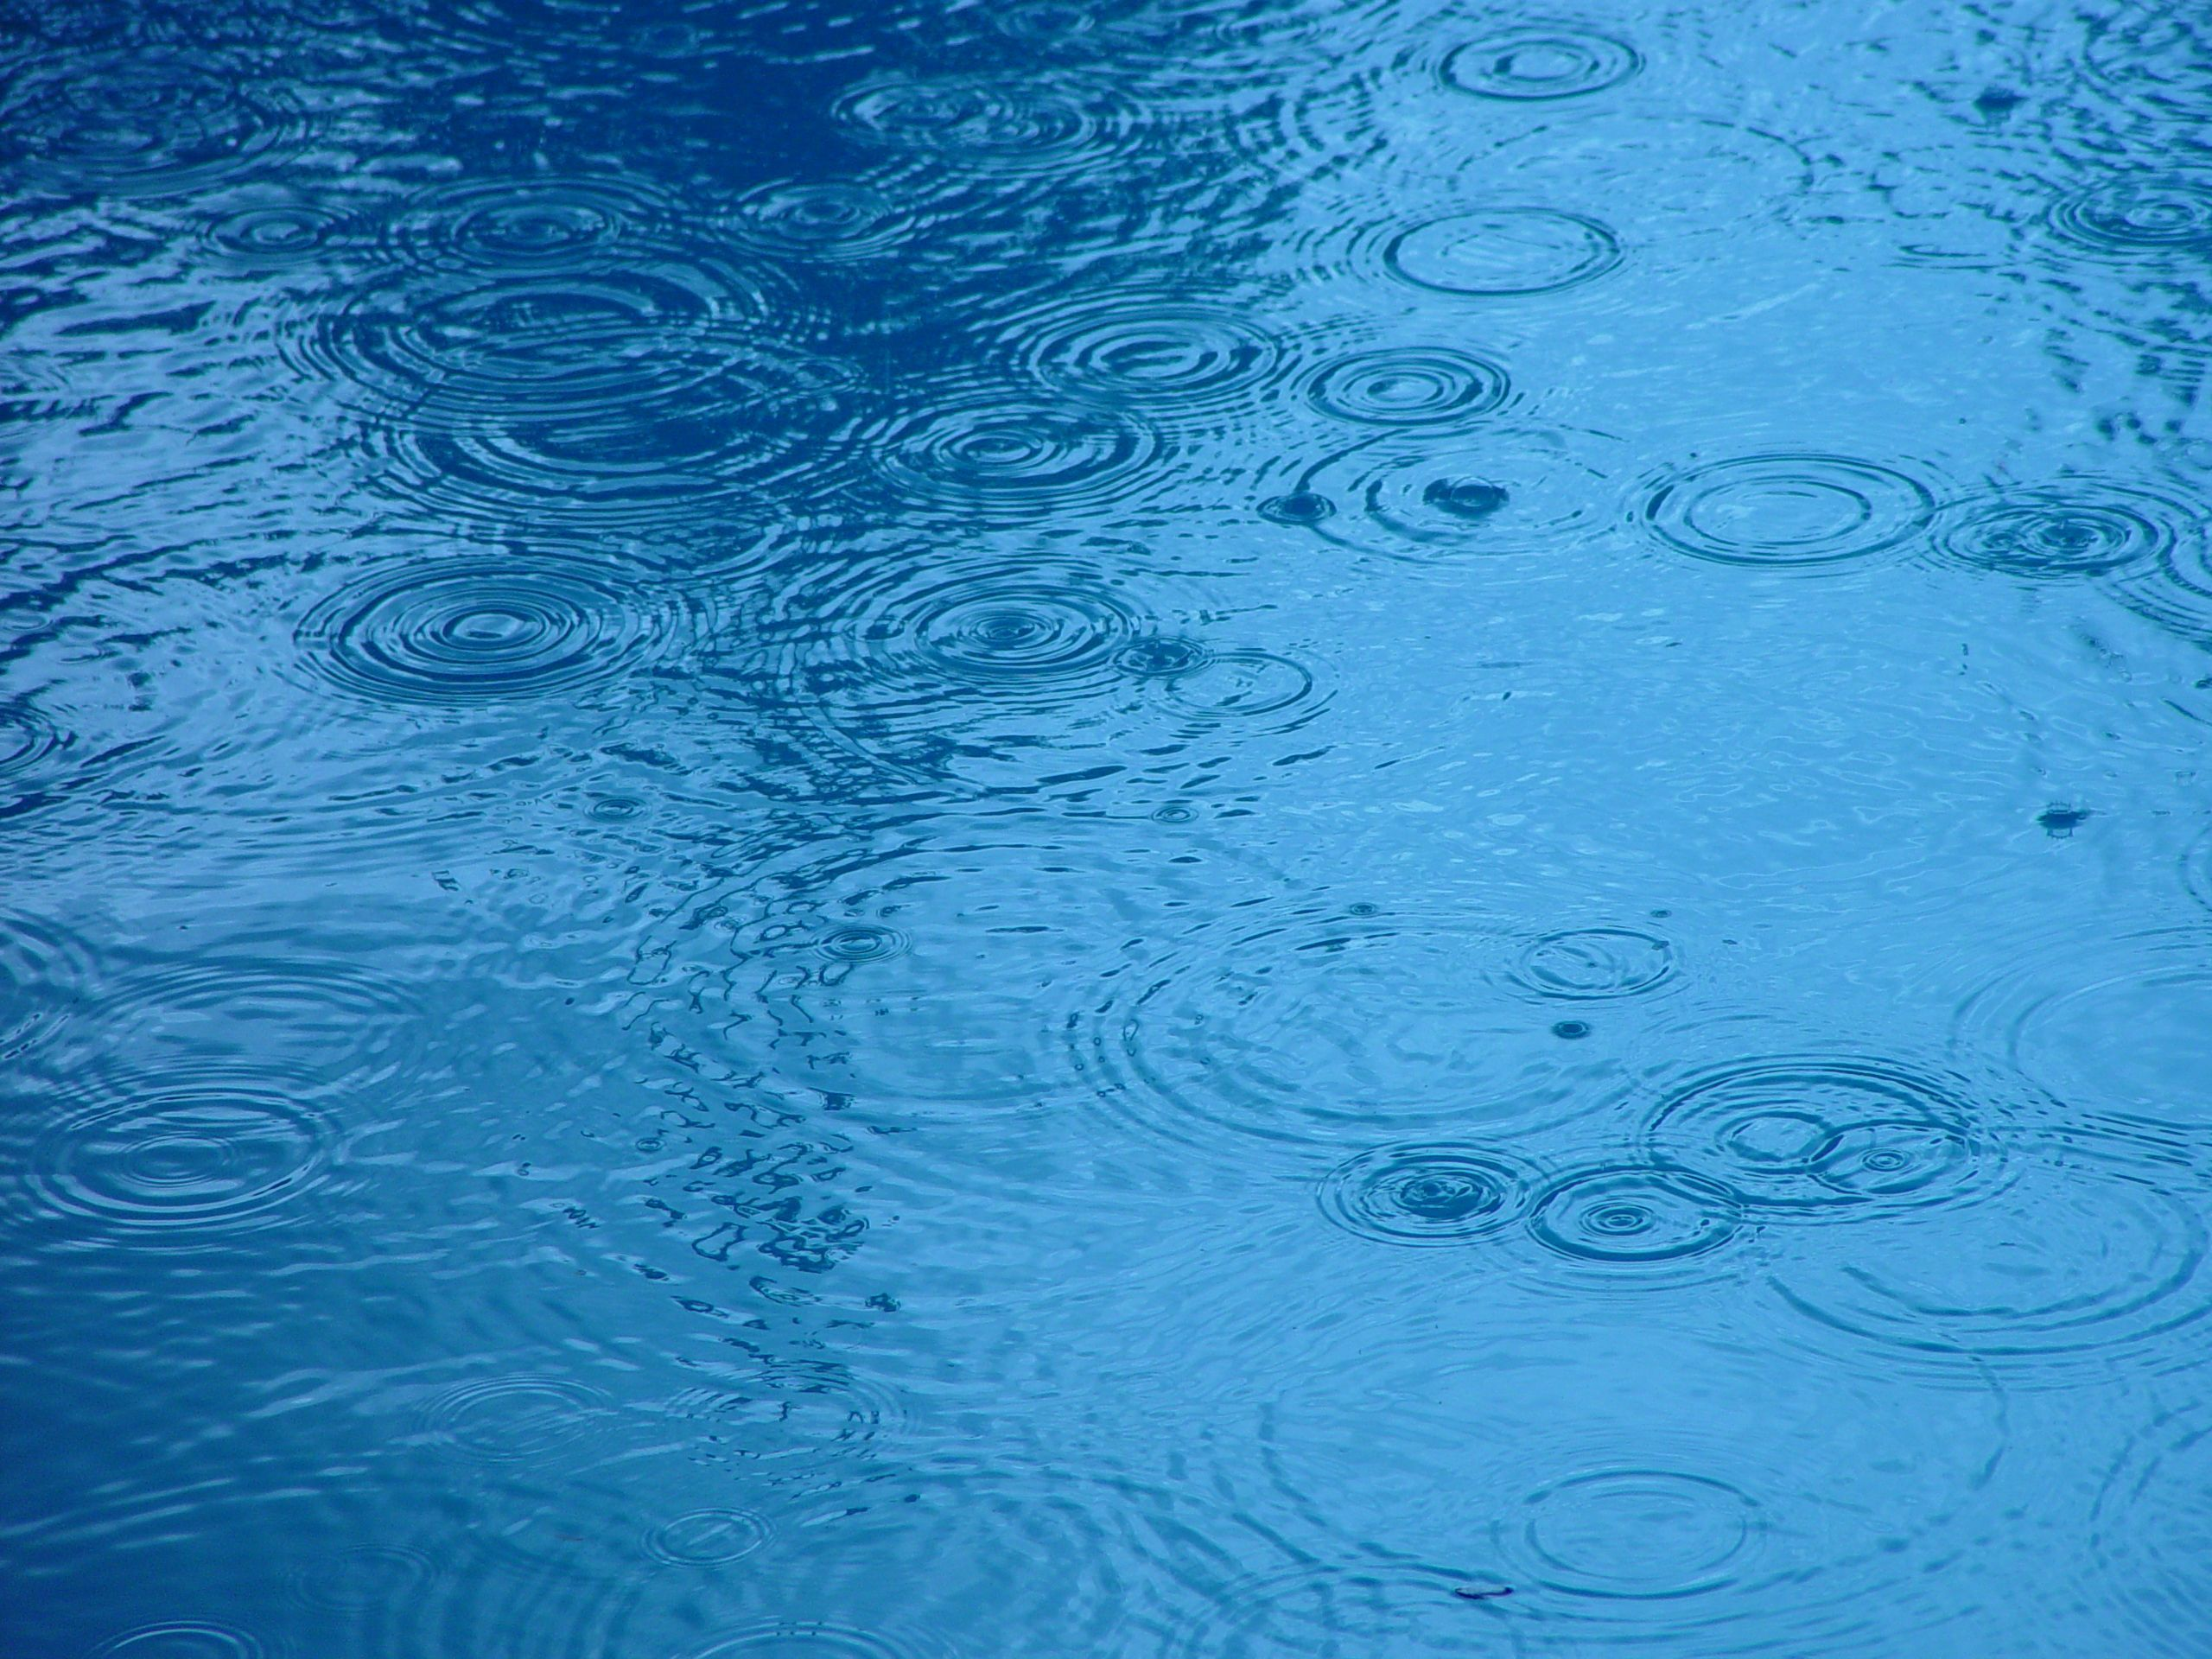



?
Considering what we know so far, where do you think daffodils flowered first?
Most Rain: South England/Wales | Least Rain: Scotland
Warmest: South England/Wales | Coldest: Scotland
Don’t forget North England had the medium temperature and rainfall!

Slide 10
?
Where did the first daffodils flower?
Scotland
North England
Plants require water and warm sunlight to grow, so daffodils grew more quickly where they had plenty of both.
However they can sometimes have too much water or sun, so this won’t always be true!
South England/Wales
Average Flowering Date for Each Area
Daffodils flowered first in South England/Wales.
Were you correct? Why do you think that is?
?

Slide 11


?
How many days are there between daffodils in the ground and daffodils in pots flowering?
= bulbs planted in the ground
= bulbs planted in pots
7 days
Scotland
North England
5 days
South England/Wales
8 days
Average Flowering Date for Each Area

Slide 12

We were surprised because our hypothesis (our idea) was that the daffodils in pots would flower first. But we were wrong!
Science is all about questioning why things happen. Now we need to think about why we were wrong.

Slide 13
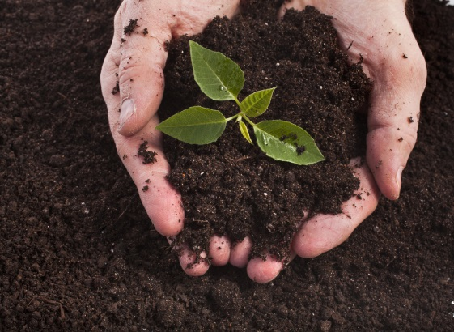
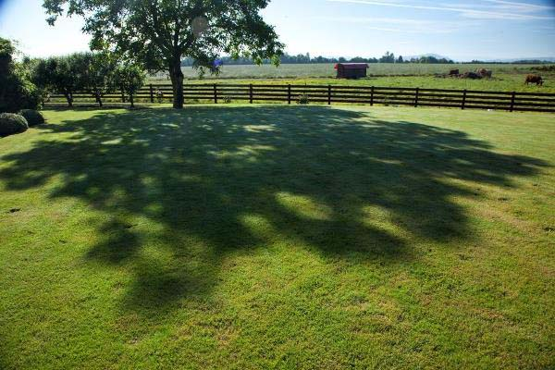
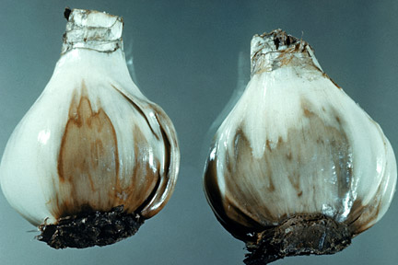
?
Why do you think the daffodils in the ground flowered before the daffodils planted in pots?
Here are some ideas of things that might affect daffodil flowering dates…
Soil quality
Shade
Pests & diseases
?
What changes could you make to the Bulb Project to test these ideas?

Slide 14
Which region had the tallest/shortest daffodils?
?
29cm
About 6cm difference
25cm
23cm
?
Using the bar chart can you estimate how tall the daffodils are?
How much taller were daffodils in South England/Wales than in North England?

Slide 15
The daffodils were tallest in South England/Wales by approximately 6cm!
This could be because:
South England/Wales was the warmest and wettest region on average. The daffodils had more sunlight and water, which they need to grow tall.
To be sure why, we would need to do more experiments.
Can you think of any other reasons why daffodils may have grown taller in South England/Wales?
?

Slide 16
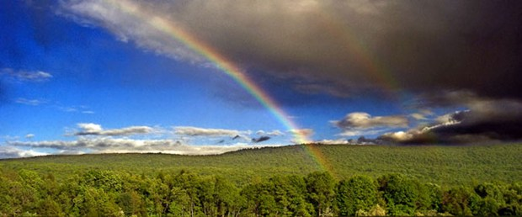
Finding a trend is quite difficult but some things are clear…
The bulbs rely on both warm sunshine and water in order to flower.
Our seasons are becoming more unpredictable as our world is getting warmer.
How do you think this will affect the growth of plants in the future?
?

