Slide 1

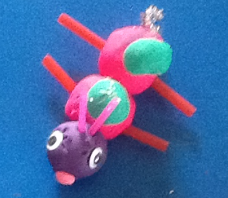
Making Reebops

Slide 2
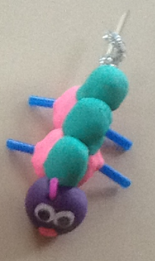
Head: play-dough
Body segments: play-dough
Humps: play-dough
Antenna: straws
Noses: pipe cleaners / play-dough
Legs: pipe cleaners / straws
Eyes: wiggly eyes
Tails: pipe cleaners
Spine: wooden skewer

Slide 3
Genotypes and Phenotypes
AA – 1 antenna | Aa – 2 antenna | aa – no antenna
QQ – red nose | Qq – orange nose | qq – yellow nose
EE – 2 eyes | Ee – 2 eyes | ee – 3 eyes
DD – 3 body segments | Dd – 3 body segments | dd – 2 body segments
MM – 1 hump | Mm – 2 humps | mm – 3 humps
TT – curly tail | Tt – curly tail | tt – straight tail
LL – blue legs | Ll – blue legs | ll – red legs

Slide 4
Preparation
The chromosomes can be printed on to paper. We have found that it is best to print and laminate slides 5 and 7, cut out the chromosomes and place a small piece of Velcro on the back of each.
Print and laminate slides 6 and 8 and put the ‘opposite’ Velcro pieces on the parents’ chromosomes.
Print and laminate slide 9, Reebop Baby, put ‘opposite’ Velcro pieces on the baby chromosomes.
This means that the chromosomes and mum, dad and baby slides are reusable.
Activity
Learners remove the chromosomes from the mum and dad slides and place them face down. A mum and a dad chromosome are chosen randomly to place on the baby chromosome slide.
Once the baby’s chromosomes are in place the genotype / phenotype table is used to decide which equipment is required to make the baby Reebop.

Slide 5

Mum chromosomes
A
a
Q
q
E
e
D
d
M
m
T
t
L
l

Slide 6
Reebops
Mum chromosomes
A
a
Q
q
E
e
D
d
M
m
T
t
L
l

Slide 7
Dad chromosomes
A
a
Q
q
E
e
D
d
M
m
T
t
L
l

Slide 8
Reebops
Dad chromosomes
A
a
Q
q
E
e
D
d
M
m
T
t
L
l

Slide 9
Reebop
Baby
AA – 1 antenna | Aa – 2 antenna | aa – no antenna
QQ – red nose | Qq – orange nose | qq – yellow nose
EE – 2 eyes | Ee – 2 eyes | ee – 3 eyes
DD – 3 body segments | Dd – 3 body segments | dd – 2 body segments
MM – 1 hump | Mm – 2 humps | mm – 3 humps
TT – curly tail | Tt – curly tail | tt – straight tail
LL – blue legs | Ll – blue legs | ll – red legs

