Slide 1



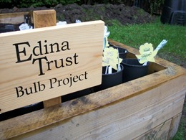
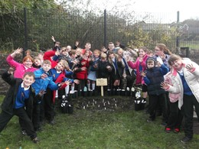
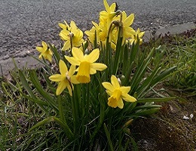
Results Report

Slide 2


The Edina Trust would like to thank everyone that worked so hard planting their bulbs, observing, and sending in their records.
We couldn’t have carried out an experiment like this without your help! You are all SUPER!
And now for the results…
Look out for questions along the way!
?

Slide 3
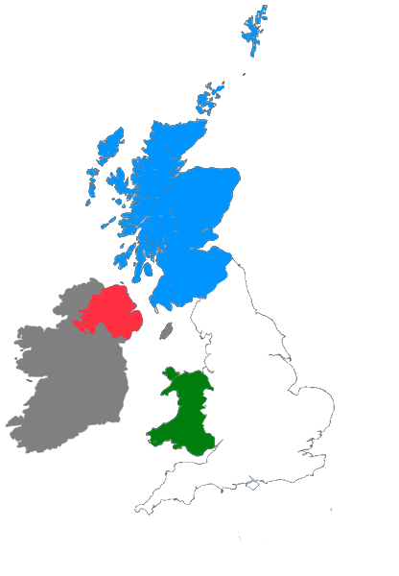
For this investigation we divided all schools into the four countries taking part:
Scotland: Dumfries & Galloway, East Ayrshire, Fife, North Lanarkshire, Renfrewshire, Scottish Borders, South Ayrshire, West Dunbartonshire, West Lothian
England: Hull, Knowsley, Lancashire, Lincolnshire, North East Lincolnshire, Oxfordshire, Sandwell, Wakefield, Wolverhampton
Northern Ireland: Belfast; Derry/Londonderry and Strabane; Fermanagh and Omagh; Newry, Mourne and Down
Wales: Blaenau Gwent, Caerphilly, Conwy, Rhondda Cynon Taf

Slide 4


?
Which country had the most rain?
62mm
61mm
60mm
45mm
During the Bulb Project, Scotland had an average of 17mm more rain per month than England.
Scotland had the most rain during the project.
Can you estimate how much more monthly rainfall there was in Scotland than England?
?

Slide 5
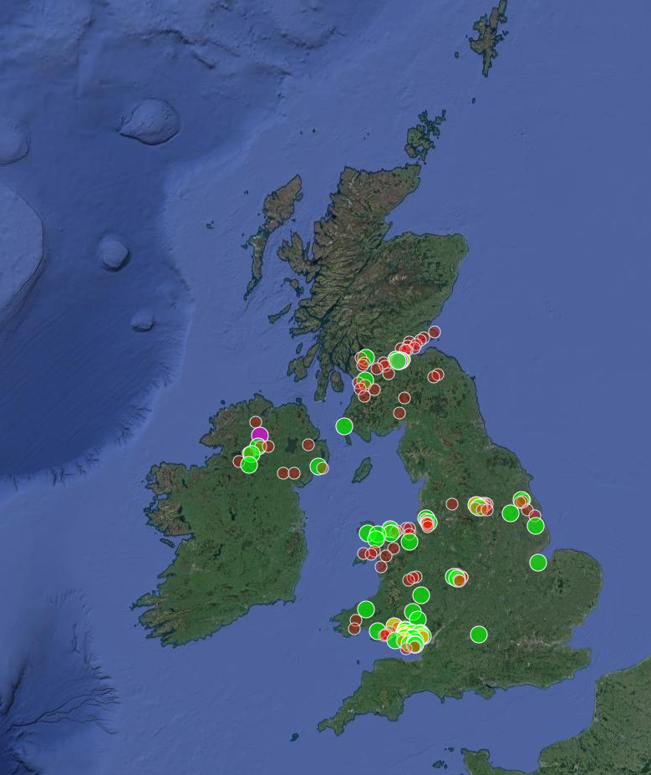

?
Which country was the warmest/coldest?
A lot of the schools in Wales are further to the south of the UK (a few schools in England are in the south as well). Schools in Scotland and Northern Ireland are further north.
Places further from the equator do not have as much direct sunlight so it is normally colder.
This affect can vary year by year. In most years we find that Scotland is the coldest country, but that didn’t happen this year!
Click here to watch the animation!
or click outside this box to skip
Wales was warmest, England was the coldest – but only just! Scotland and Northern Ireland were almost the same temperature. Why do you think that is?
?

Slide 7
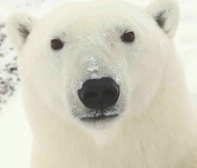
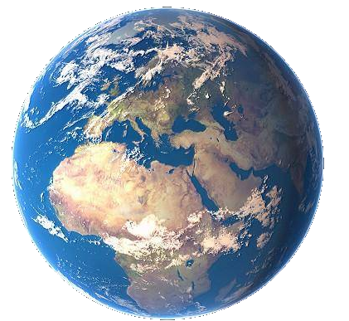
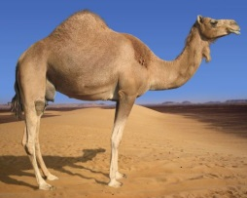

As the sunlight is shining on the Earth…
UK
This makes it warm at the equator and cold at the North and South Pole!
Equator
…the same amount of light and warmth is spread across more of the surface than at the equator.
Click here to replay!
or click outside this box to move on.

Slide 8
?
Which country was the warmest
in January?
Wales was the warmest country in January.

Slide 9
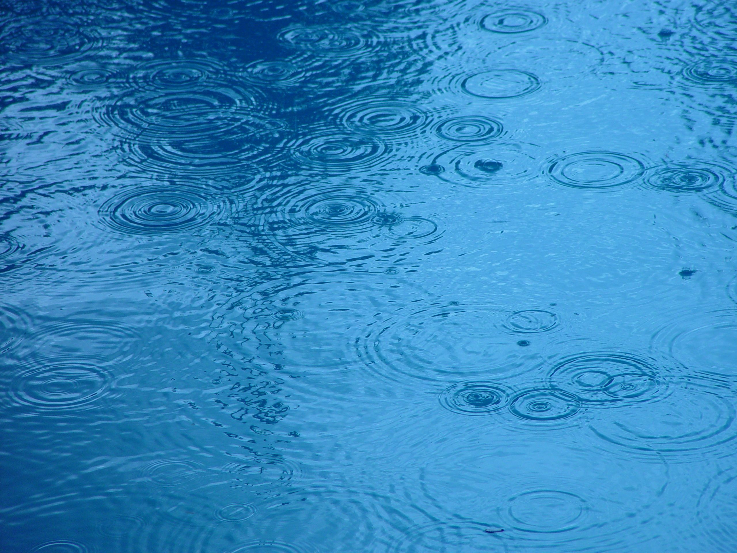

?
Considering what we know so far, where do you think daffodils flowered first?
2021-22 Weather Data from Schools
Most Rain: Scotland Northern Ireland and Wales had almost as much rain as Scotland. England had the least rain | Warmest: Wales England, Northern Ireland, and Scotland were almost all the same temperature. England was the coldest by a little bit.

Slide 10





?
Where did the first daffodils flower?
1. Wales – 28th February
27
28
8
1
9
2
10
26
5
3
11
15
25
7
4
17
18
2. England – 7th March
16
Click to start the animation and find out!
6
13
12
14
Plants require water and warm sunlight to grow, so daffodils grew more quickly where they had plenty of both.
However they can sometimes have too much water or sun, so this won’t always be true!
3. N. Ireland – 9th March
4. Scotland– 18th March
Feb
Note: These are the average dates for bulbs in pots AND bulbs in the ground.
Feb
March
March
March
March
March
Feb
March
March
March
March
Feb
March
March
March
March
March
March
March
March
March
Daffodils flowered first in Wales!
Were you correct? Why do you think that is?
?

Slide 11

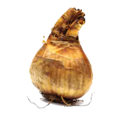
Our hypothesis for the Bulb Project is that daffodils in pots will flower before those in the ground.
We think this is because bulbs in the ground are more insulated, so they do not “feel” the changes in temperature as much.
The weather is freezing today!
Let’s find out what happened, using the data sent by our Super Scientists… (You!)
We’re plenty warm down here!

Slide 12






How many days difference was there between the daffodil flowering dates?
?
= bulbs planted in the ground
= bulbs planted in pots
?
?
?
?
7
11
2
days difference
England
6
Scotland
N. Ireland
Wales
February
M | T | W | T | F | S | S
 | 1 | 2 | 3 | 4 | 5 | 6
7 | 8 | 9 | 10 | 11 | 12 | 13
14 | 15 | 16 | 17 | 18 | 19 | 20
21 | 22 | 23 | 24 | 25 | 26 | 27
28
March
M | T | W | T | F | S | S
 | 1 | 2 | 3 | 4 | 5 | 6
7 | 8 | 9 | 10 | 11 | 12 | 13
14 | 15 | 16 | 17 | 18 | 19 | 20
21 | 22 | 23 | 24 | 25 | 26 | 27
28 | 29 | 30 | 31
Average Flowering Date for Each Country

Slide 13
Here are the average flowering dates across the whole of the UK compared to last year:
 | 2021 | 2022
Daffodils in Pots | 12th March | 12th March
Daffodils in the Ground | 13th March | 5th March
The average flowering date for daffodils planted in pots was the same in 2021 and in 2022! But this year, daffodils planted in the ground flowered earlier.
It is important to keep in mind that the lockdown restrictions might have affected the results. Schools may not have had access to their bulbs to report flowering dates all through February and March in 2020 or in 2021.

Slide 14
Our hypothesis was not supported by the data this year. Daffodils in the ground flowered first in every country!
Even though we were “wrong”, this is very important data. Now we need to think about why daffodils planted in the ground flowered first.
Do you have any ideas?
?

Slide 15
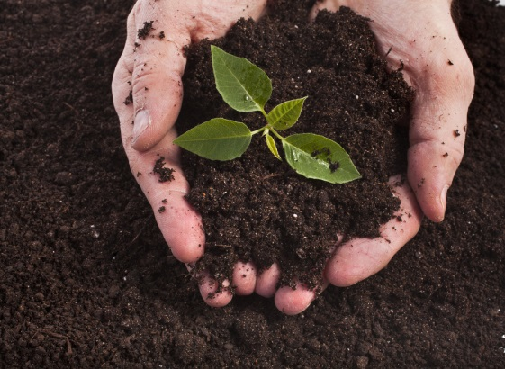
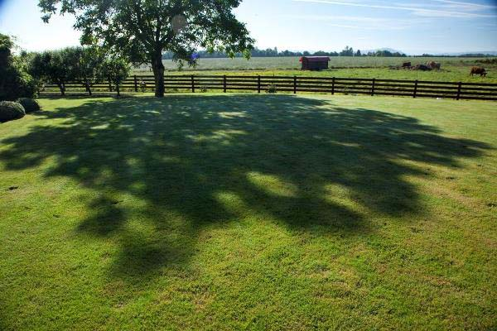
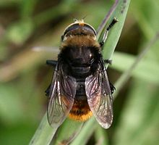
?
Do you think there could be other reasons for bulbs to flower earlier or later?
I’m not a bee! I’m a Narcissus Fly and I eat daffodil bulbs. I look like a bee to make other animals think I can sting!
Here are some ideas of things that might affect daffodil flowering dates…
Soil quality
Shade
Pests & diseases
?
What changes could you make to the Bulb Project to test these ideas?

Slide 16

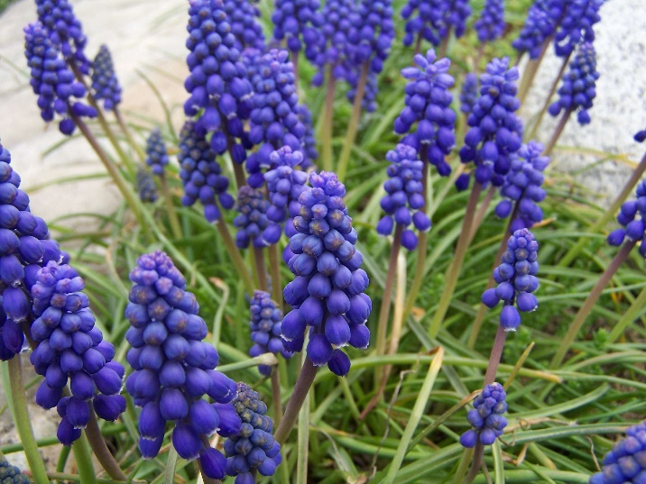
Mystery Bulbs!
Have your mystery bulbs flowered yet?
You can click the box to see a photo of the same type of flower!
(You can click elsewhere to skip if yours haven’t flowered and you don’t want to be spoiled!)
Click Here
to reveal the mystery bulb flowers!
?
Can you find out what kind of flower this is?
Have you seen any growing in gardens or parks near your home?
Click here to reveal the answer!
These are grape hyacinths (Muscari armeniacum)
?

Slide 17
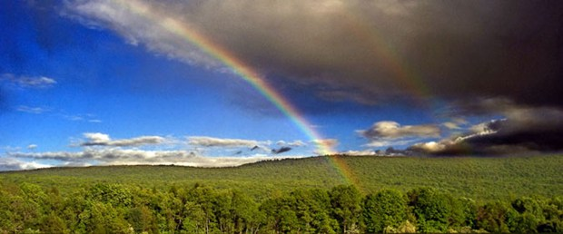
Finding a trend is quite difficult but some things are clear…
The bulbs rely on both warm sunshine and water in order to flower.
Our seasons are becoming more unpredictable as our world is getting warmer.
How do you think this will affect the growth of plants in the future?
?

