Slide 1


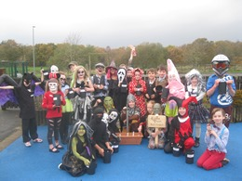
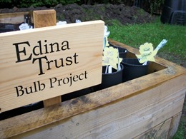
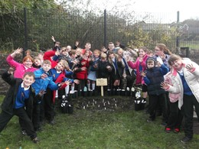
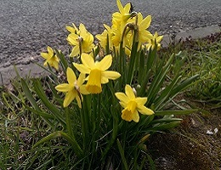
Results Report

Slide 2


Super Scientists!
The Edina Trust would like to thank everyone that worked so hard planting their bulbs, observing, and sending in their records.
We couldn’t have carried out an experiment like this without your help!
And now for the results…
Look out for questions along the way!
?

Slide 3
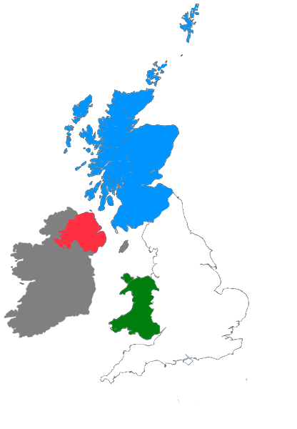
For this investigation we divided all schools into the four countries taking part:
Scotland: Dumfries & Galloway, Dundee, East Ayrshire, Fife, North Lanarkshire, Renfrewshire, Scottish Borders, South Lanarkshire, West Dunbartonshire
England: Hull, Lancashire, Lincolnshire, North East Lincolnshire, Oxfordshire, Sunderland, Wakefield, Wolverhampton
Northern Ireland: Belfast, Derry/Londonderry, Strabane
Wales: Blaenau Gwent, Caerphilly, Conwy, Rhondda Cynon Taf

Slide 4


?
Which country had the most rain?
During the Bulb Project, Wales had an average of 31mm more rain per month than Northern Ireland.
Wales had the most rain during the project.
Can you estimate how much more monthly rainfall there was in Wales than Northern Ireland?
?

Slide 5

?
Which country was the warmest/coldest?
Scotland is further north than England (it has a higher latitude). Places further from the equator do not have as much direct sunlight so it is normally colder.
Click here to watch the animation!
or click outside this box to skip
Wales was warmest, Scotland was coldest.
Why do you think that is? Why might Scotland have been the coldest area?
?

Slide 7
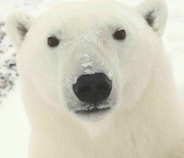
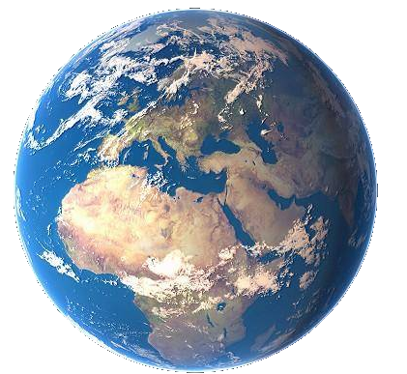
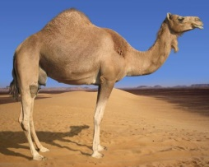

As the sunlight is shining on the Earth…
UK
This makes it warm at the equator and cold at the North and South Pole!
Equator
…the same amount of light and warmth is spread across more of the surface than at the equator.
Click here to replay!
or click outside this box to move on.

Slide 8
?
Which country was the warmest
in January?
Wales was the warmest region in January.

Slide 9
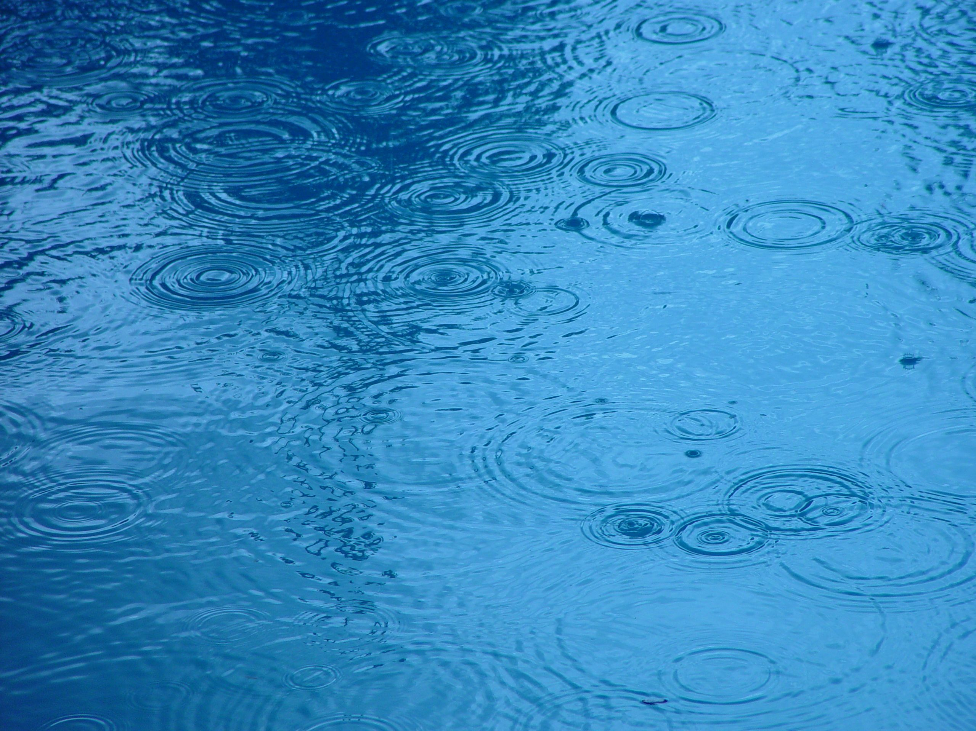

?
Considering what we know so far, where do you think daffodils flowered first?
Most Rain: 1 – Wales 2 – Scotland 3 – England 4 – Northern Ireland | Warmest: 1 – Wales 2 – Northern Ireland 3 – England 4 – Scotland

Slide 10





?
Where did the first daffodils flower?
1. Wales – 27th February
28
2. England – 5th March
21
23
29
24
5
2
12
27
1
14
7
10
13
8
20
22
25
26
11
9
6
4
3
Click to start the animation and find out!
3. N. Ireland – 13th March
Plants require water and warm sunlight to grow, so daffodils grew more quickly where they had plenty of both.
However they can sometimes have too much water or sun, so this won’t always be true!
4. Scotland – 14th March
Note: These are the average dates for bulbs in pots AND bulbs in the ground.
February
February
February
February
February
March
March
March
February
March
March
March
March
March
March
February
February
February
February
March
March
March
March
March
Daffodils flowered first in Wales!
Were you correct? Why do you think that is?
?

Slide 11






How many days difference was there between the daffodil flowering dates?
?
= bulbs planted in the ground
= bulbs planted in pots
= each box represents one day
Scotland
10 days
England
3 days
N. Ireland
16 days
Wales
6 days
17th Feb
24th Feb
2nd Mar
9th Feb
16th Mar
23rd Mar
Average Flowering Date for Each Country

Slide 12

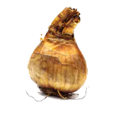
Our hypothesis was that daffodils in pots would flower before those in the ground.
We think this is because bulbs in the ground are more insulated, so they do not “feel” the changes in temperature as much.
This year daffodils in the ground flowered first in every country except Scotland!
We would need to do more experiments to find out why! Do you have any ideas?

Slide 13
Here are the average flowering dates across the whole of the UK compared to last year:
 | 2019 | 2020
Daffodils in Pots | 27th February | 7th March
Daffodils in the Ground | 1st March | 3rd March
For both daffodils in pots and in the ground, the flowering date was later this year.
However, the dates are very close. There is about a week’s difference for daffodils in pots, and only two days for those planted in the ground.

Slide 14
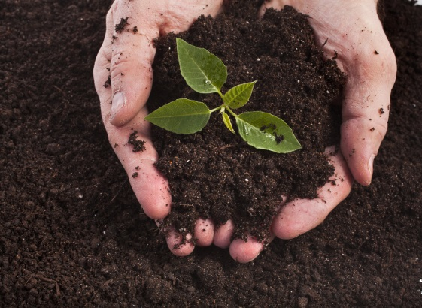
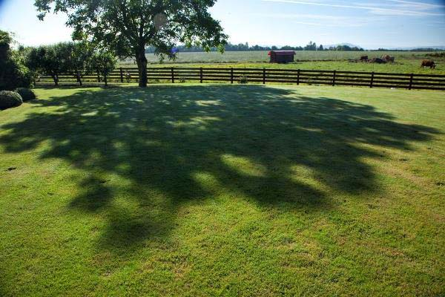
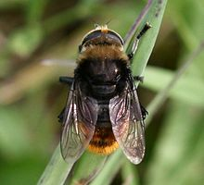
?
Do you think there could be other reasons for bulbs to flower earlier or later?
I’m not a bee! I’m a Narcissus Fly and I eat daffodil bulbs. I look like a bee so other animals think I can sting!
Here are some ideas of things that might affect daffodil flowering dates…
Soil quality
Shade
Pests & diseases
?
What changes could you make to the Bulb Project to test these ideas?

Slide 15
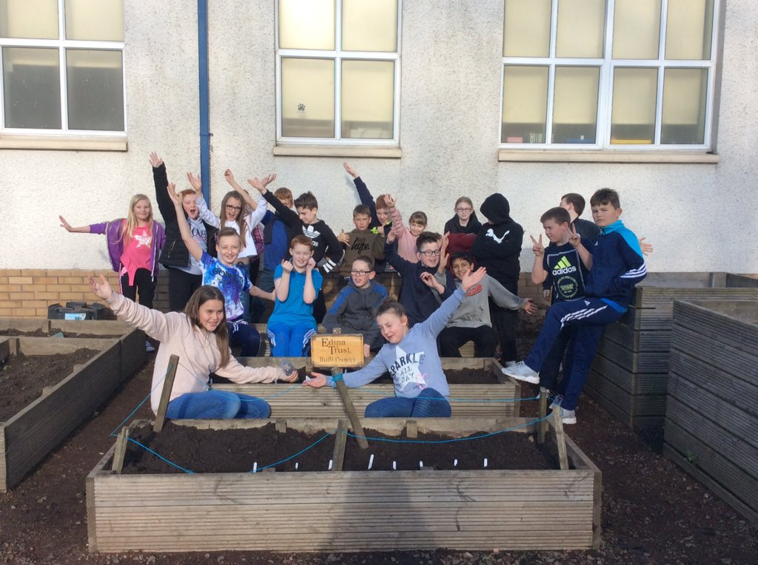
Another thing to consider…
This year, most schools had to close before the end of the Bulb Project. Because of this, we did not receive as much data as usual.
In 2019 we received dates for more than 2,300 flowers.
This year we received dates for 1,170 flowers.
Many schools reported that their daffodils didn’t flower before their school had to close.
Do you think this could have affected our results?

Slide 16
Which country had the tallest/shortest daffodils?
?
25cm
Average Height (cm)
24cm
23cm
About 4cm difference
Why do you think the daffodils grew the tallest in Wales?
21cm
?
Using the bar chart can you work out how tall the daffodils are?
How much taller were daffodils in Wales compared to Scotland?

Slide 17
On average, the daffodils were tallest in Wales.
Wales was the warmest area
Wales had the most rain
The warm sunshine could have helped the daffodils to grow tall.
The daffodils received plenty of water from the rain.
To be sure why, we would need to do more experiments.
Can you think of any other reasons why daffodils grew taller in Wales?
?

Slide 18
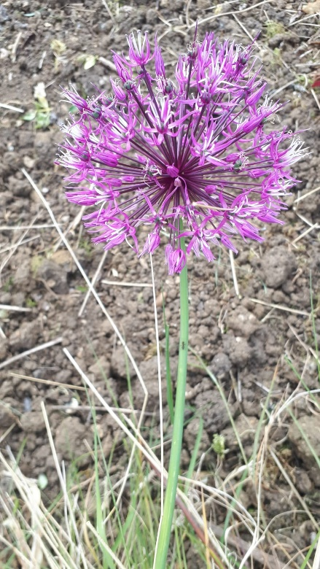
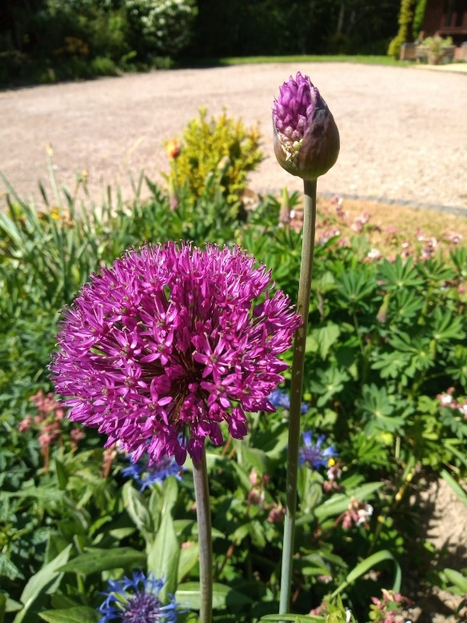
Mystery Bulbs!
Sadly, you may not have been able to see your mystery bulbs flowering this year because schools had to close down. Here are some photos of the same species of flower!
?
Can you find out what kind of flower this is?
Have you seen any growing in gardens or parks near your home?
?

Slide 19
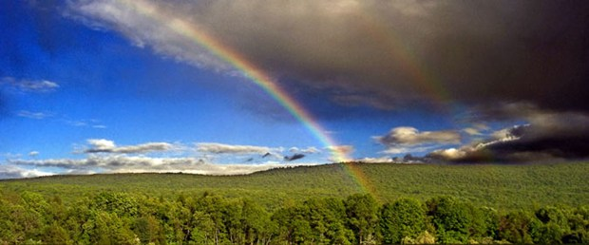
Finding a trend is quite difficult but some things are clear…
The bulbs rely on both warm sunshine and water in order to flower.
Our seasons are becoming more unpredictable as our world is getting warmer.
How do you think this will affect the growth of plants in the future?
?

