Slide 1



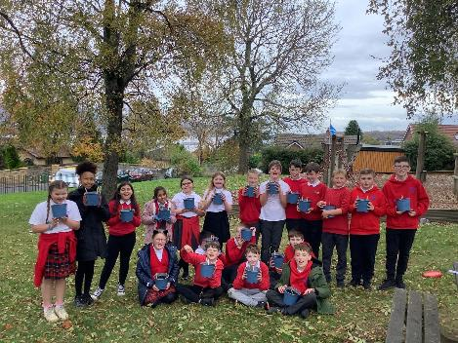
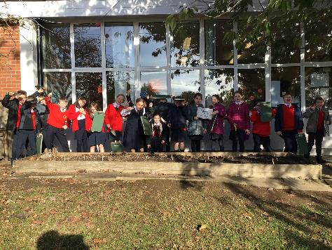
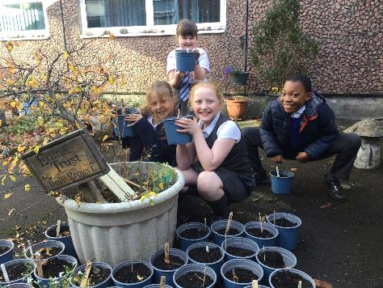
Results Report
2025

Slide 2


The Edina Trust would like to thank everyone who worked so hard planting their bulbs, observing, and sending in their records.
We couldn’t have carried out an experiment like this without your help! You are all SUPER!
And now for the results…
Look out for questions along the way!
?

Slide 3
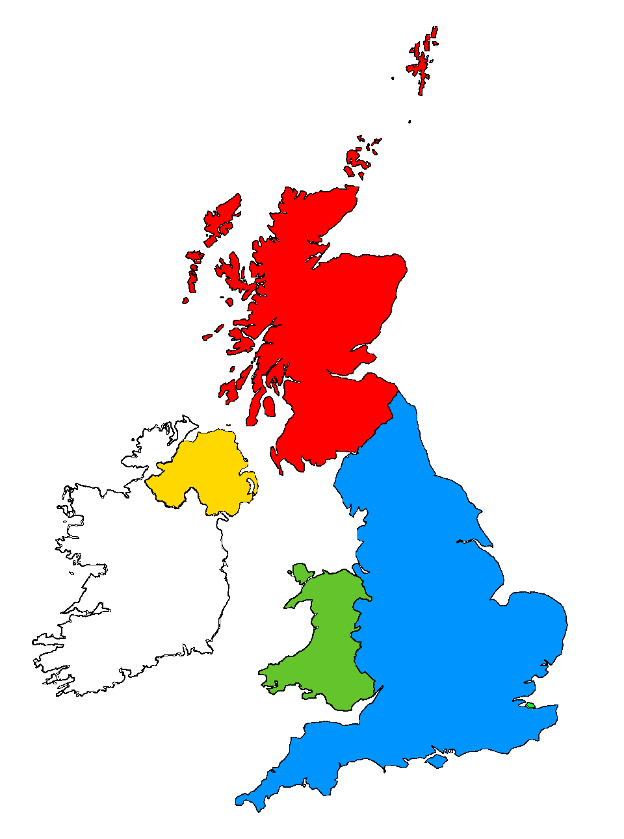
For this investigation we divided all schools into the four countries taking part:
Scotland
England
Northern Ireland
Wales

Slide 4


?
Which country had the most rain?
350mm
278mm
243mm
238mm
During the Bulb Project, Wales had an average of 112mm more rain than Northern Ireland.
Wales had the most rain during the project this year.
Can you estimate how much more rainfall there was in Wales compared to Northern Ireland?
?

Slide 5


?
Which country was the warmest/coldest?
Click here to watch the animation!
or click outside this box to skip
Scotland is further north (it has a higher latitude). Places further from the equator do not have as much direct sunlight so it is normally colder.
Northern Ireland was warmest this time, and Scotland was the coldest
?
Why do you think Scotland was colder than the rest of the UK?

Slide 7

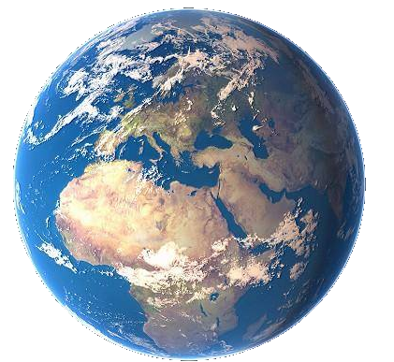
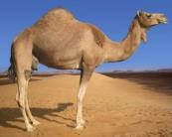

As the sunlight is shining on the Earth…
UK
This makes it warm at the equator and cold at the North and South Pole!
Equator
…the same amount of light and warmth is spread across more of the surface than at the equator.
Click here to replay!
or click outside this box to move on.

Slide 8

Which country was the coldest
in December?
?
Scotland was the coldest country in December.

Slide 9
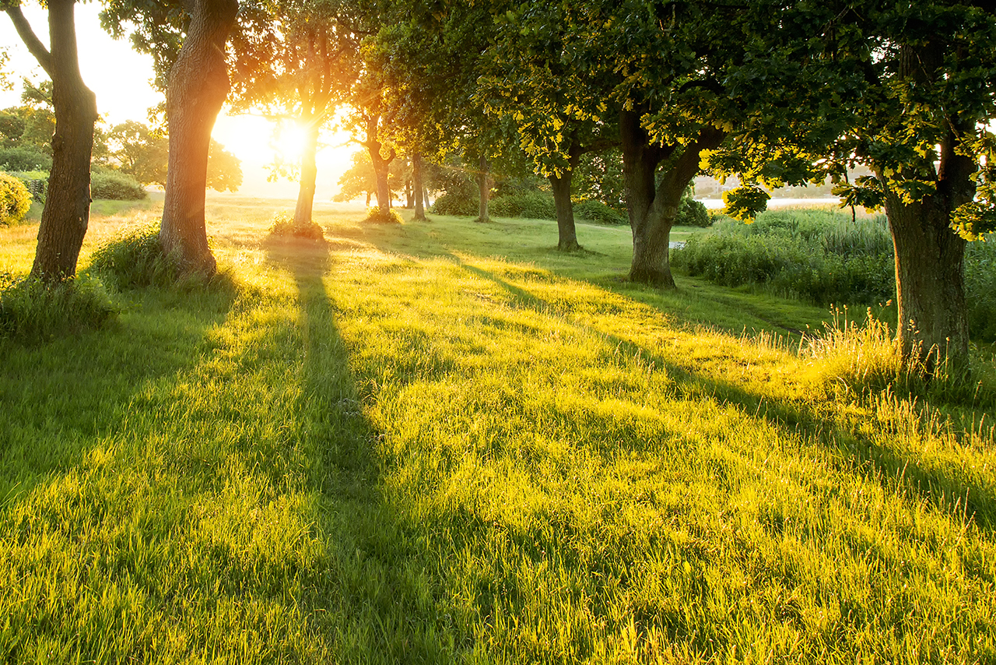
Which country was the warmest
in March?
?
England was the warmest country in March.

Slide 10
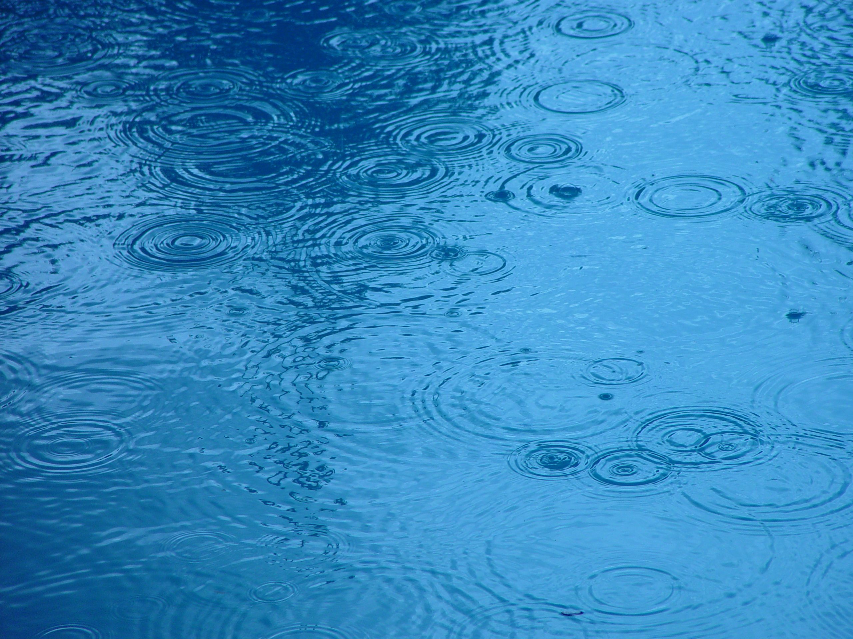

?
Considering what we know so far, where do you think daffodils flowered first?
2024/25 Weather Data from Schools
Most Rain: Wales England and Scotland were in the middle. Northern Ireland was the driest. | Warmest: Northern Ireland England and Wales were in the middle. Scotland was the coldest.

Slide 11





?
Where did the first daffodils flower?
1. Scotland – 3rd March
4
1
3
2
5
6
7
2. Wales – 5th March
Click to start the animation and find out!
3. N. Ireland – 6th March
4. England – 7th March
Plants require water and warm sunlight to grow.
However they can sometimes have too much water or sun, and other factors can affect the flowering date too.
Note: These include the dates for bulbs in pots AND bulbs in the ground.
March
March
March
March
March
March
March
Daffodils flowered first in Scotland this year!
Were you correct? Why do you think that is?
?

Slide 12

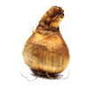
Our hypothesis for the Bulb Project is that daffodils in pots will flower before those in the ground.
We think this is because bulbs in the ground are more insulated, so they do not “feel” the changes in temperature as much.
The weather is warming up today!
Let’s find out what happened, using the data sent by our Super Scientists… (You!)
I wonder if it’s spring up there yet?

Slide 13






How many days difference was there between the daffodil flowering dates?
?
= bulbs planted in the ground
= bulbs planted in pots
?
?
?
N. Ireland
?
England
1
Scotland
Wales
3
8
day(s) difference
5
March
M | T | W | T | F | S | S
 |  |  |  | 1 | 2 | 3
4 | 5 | 6 | 7 | 8 | 9 | 10
11 | 12 | 13 | 14 | 15 | 16 | 17
18 | 19 | 20 | 21 | 22 | 23 | 24
25 | 26 | 27 | 28 | 29 | 30 | 31
Average Flowering Date for Each Country

Slide 14
Here are the average flowering dates across the whole of the UK compared to last year:
 | 2024 | 2025
Daffodils in Pots | 6th March | 6th March
Daffodils in the Ground | 3rd March | 8th March
The average flowering date for bulbs in pots was the same in both 2024 and 2025.
Bulbs planted in the ground flowered 5 days later in 2025. However, the dates are still close! There was not a big difference.

Slide 15
Our hypothesis was not supported by the data this year. Daffodils planted in pots flowered first, but the difference was only 2 days.
The difference is so small that we can say it is ‘not significant’.

Slide 16
Here are the average flowering dates across the whole of the UK since 2020-21.
2020/21 | 2021/22 | 2022/23 | 2023/24 | 2024/25
12th March | 8th March | 19th March | 4th March | 7th March
Let’s compare these results with the weather recordings...
Here’s the average temperature from the Bulb Project each year across the UK.
?
Do you think this data shows that the temperature affected the flowering date?

Slide 17
Here are the average flowering dates across the whole of the UK since 2020-21.
2020/21 | 2021/22 | 2022/23 | 2023/24 | 2024/25
12th March | 8th March | 19th March | 4th March | 7th March
This time it’s the average rainfall from the Bulb Project each year across the UK.
?
Do you think this data shows that the amount of rain affected the flowering date?

Slide 18
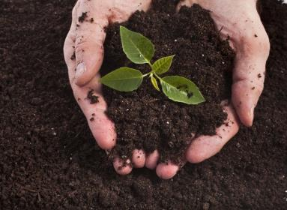
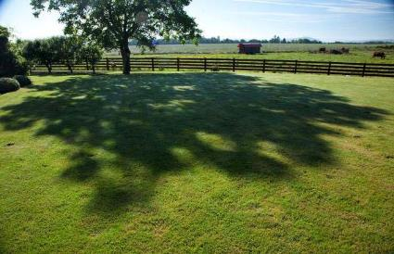
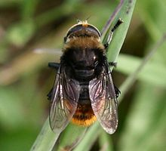
?
Do you think there could be other reasons for bulbs to flower earlier or later?
I’m not a bee! I’m a Narcissus Fly and I eat daffodil bulbs. I look like a bee to make other animals think I can sting!
Here are some ideas of things that might affect daffodil flowering dates…
Soil quality
Shade
Pests & diseases
?
What changes could you make to the Bulb Project to test these ideas?

Slide 19
Which country had the tallest/shortest daffodils?
?
Only 2cm difference!
25cm
24cm
24cm
23cm
Consider what daffodils and other plants need to grow.
?
Why do you think the daffodils grew the tallest in Scotland?
Using the bar chart can you work out how tall the daffodils are?
How much taller were daffodils in Scotland compared to Wales?

Slide 20

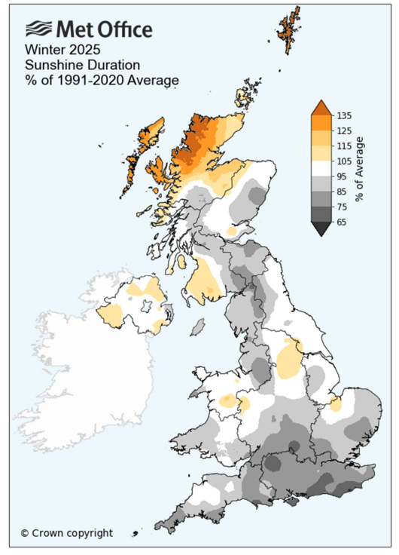
Here’s a map from the Met Office showing the amount of sunshine in December, January, and February.
This isn’t something we can measure as part of the project - unless you were at school all day, every day!
Yellow/orange = more sunny days
Grey = fewer sunny days
?
What can you notice about the amount of sunshine in different areas?
?
Do you think the amount of sunshine can affect the growth of your bulbs?
Check out the Met Office report 

Slide 21
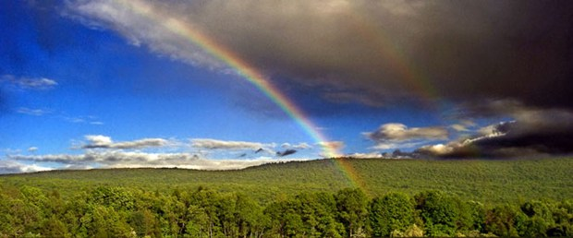
Finding a trend is quite difficult but some things are clear…
The bulbs rely on both warm sunshine and water in order to flower.
Our seasons are becoming more unpredictable as our world is getting warmer.
How do you think this might affect the growth of plants in the future?
?

Slide 22
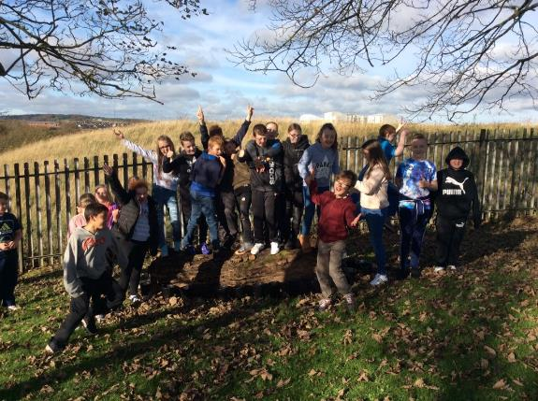
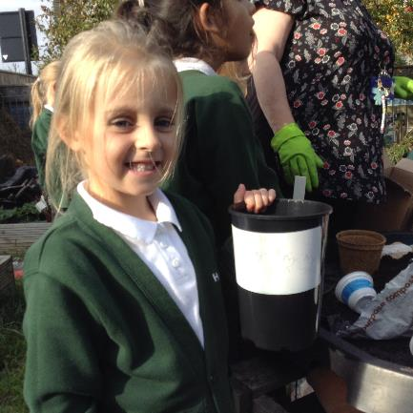

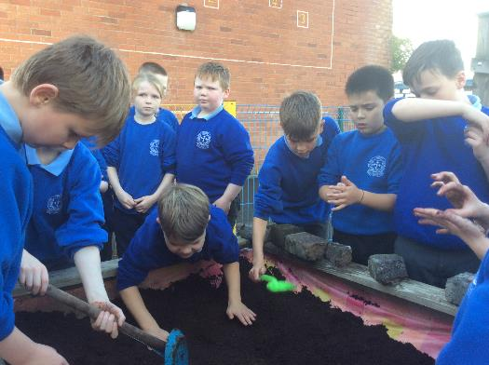
Thank you for taking part!

