Slide 1


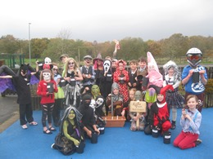
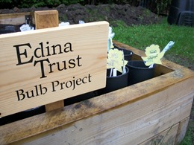
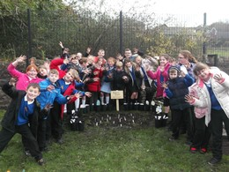
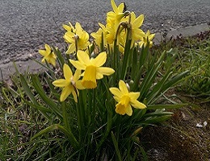
Results Report

Slide 2

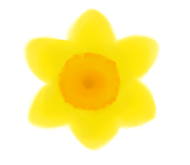
The Edina Trust would like to thank everyone that worked so hard planting their bulbs, observing, and sending in their records.
We couldn’t have carried out an experiment like this without your help!
And now for the results…
Look out for questions along the way!
?

Slide 3
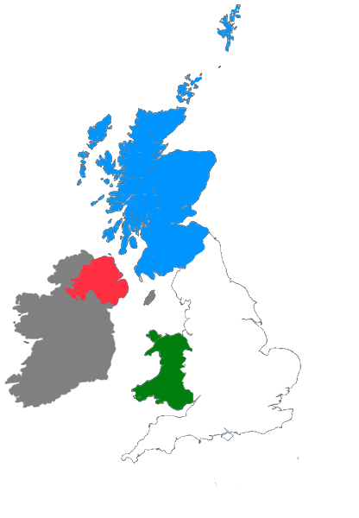
For this investigation we divided all schools into the four countries taking part:
Scotland: Dumfries & Galloway, East Ayrshire, Fife, North Lanarkshire, Renfrewshire, Scottish Borders, West Dunbartonshire, West Lothian
England: Hull, Knowsley, Lancashire, Lincolnshire, North East Lincolnshire, Oxfordshire, Wakefield, Wolverhampton
Northern Ireland: Belfast, Derry/Londonderry, Strabane, Fermanagh, Omagh, Newry, Mourne and Down
Wales: Blaenau Gwent, Caerphilly, Conwy, Rhondda Cynon Taf

Slide 4


?
Which country had the most rain?
53mm
34mm
During the Bulb Project, Wales had an average of 19mm more rain per month than England.
Wales had the most rain during the project.
Can you estimate how much more monthly rainfall there was in Wales than England?
?

Slide 5

?
Which country was the warmest/coldest?
Scotland is further north (it has a higher latitude). Places further from the equator do not have as much direct sunlight so it is normally colder.
Click here to watch the animation!
or click outside this box to skip
Wales was warmest, Scotland was coldest (but only just!)
Why do you think that is? Why might Scotland have been the coldest area?
?

Slide 7
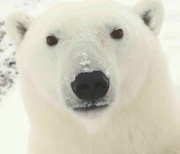
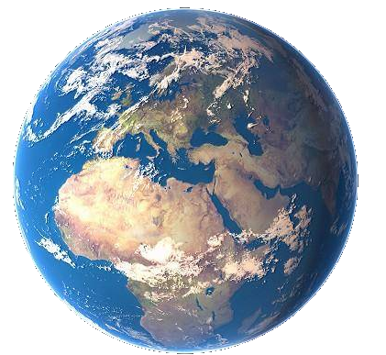
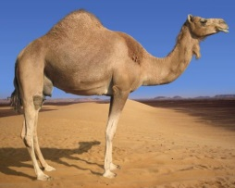
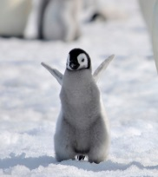
As the sunlight is shining on the Earth…
UK
This makes it warm at the equator and cold at the North and South Pole!
Equator
…the same amount of light and warmth is spread across more of the surface than at the equator.
Click here to replay!
or click outside this box to move on.

Slide 8
?
Which country was the warmest
in January?
Wales was the warmest country in January.

Slide 9
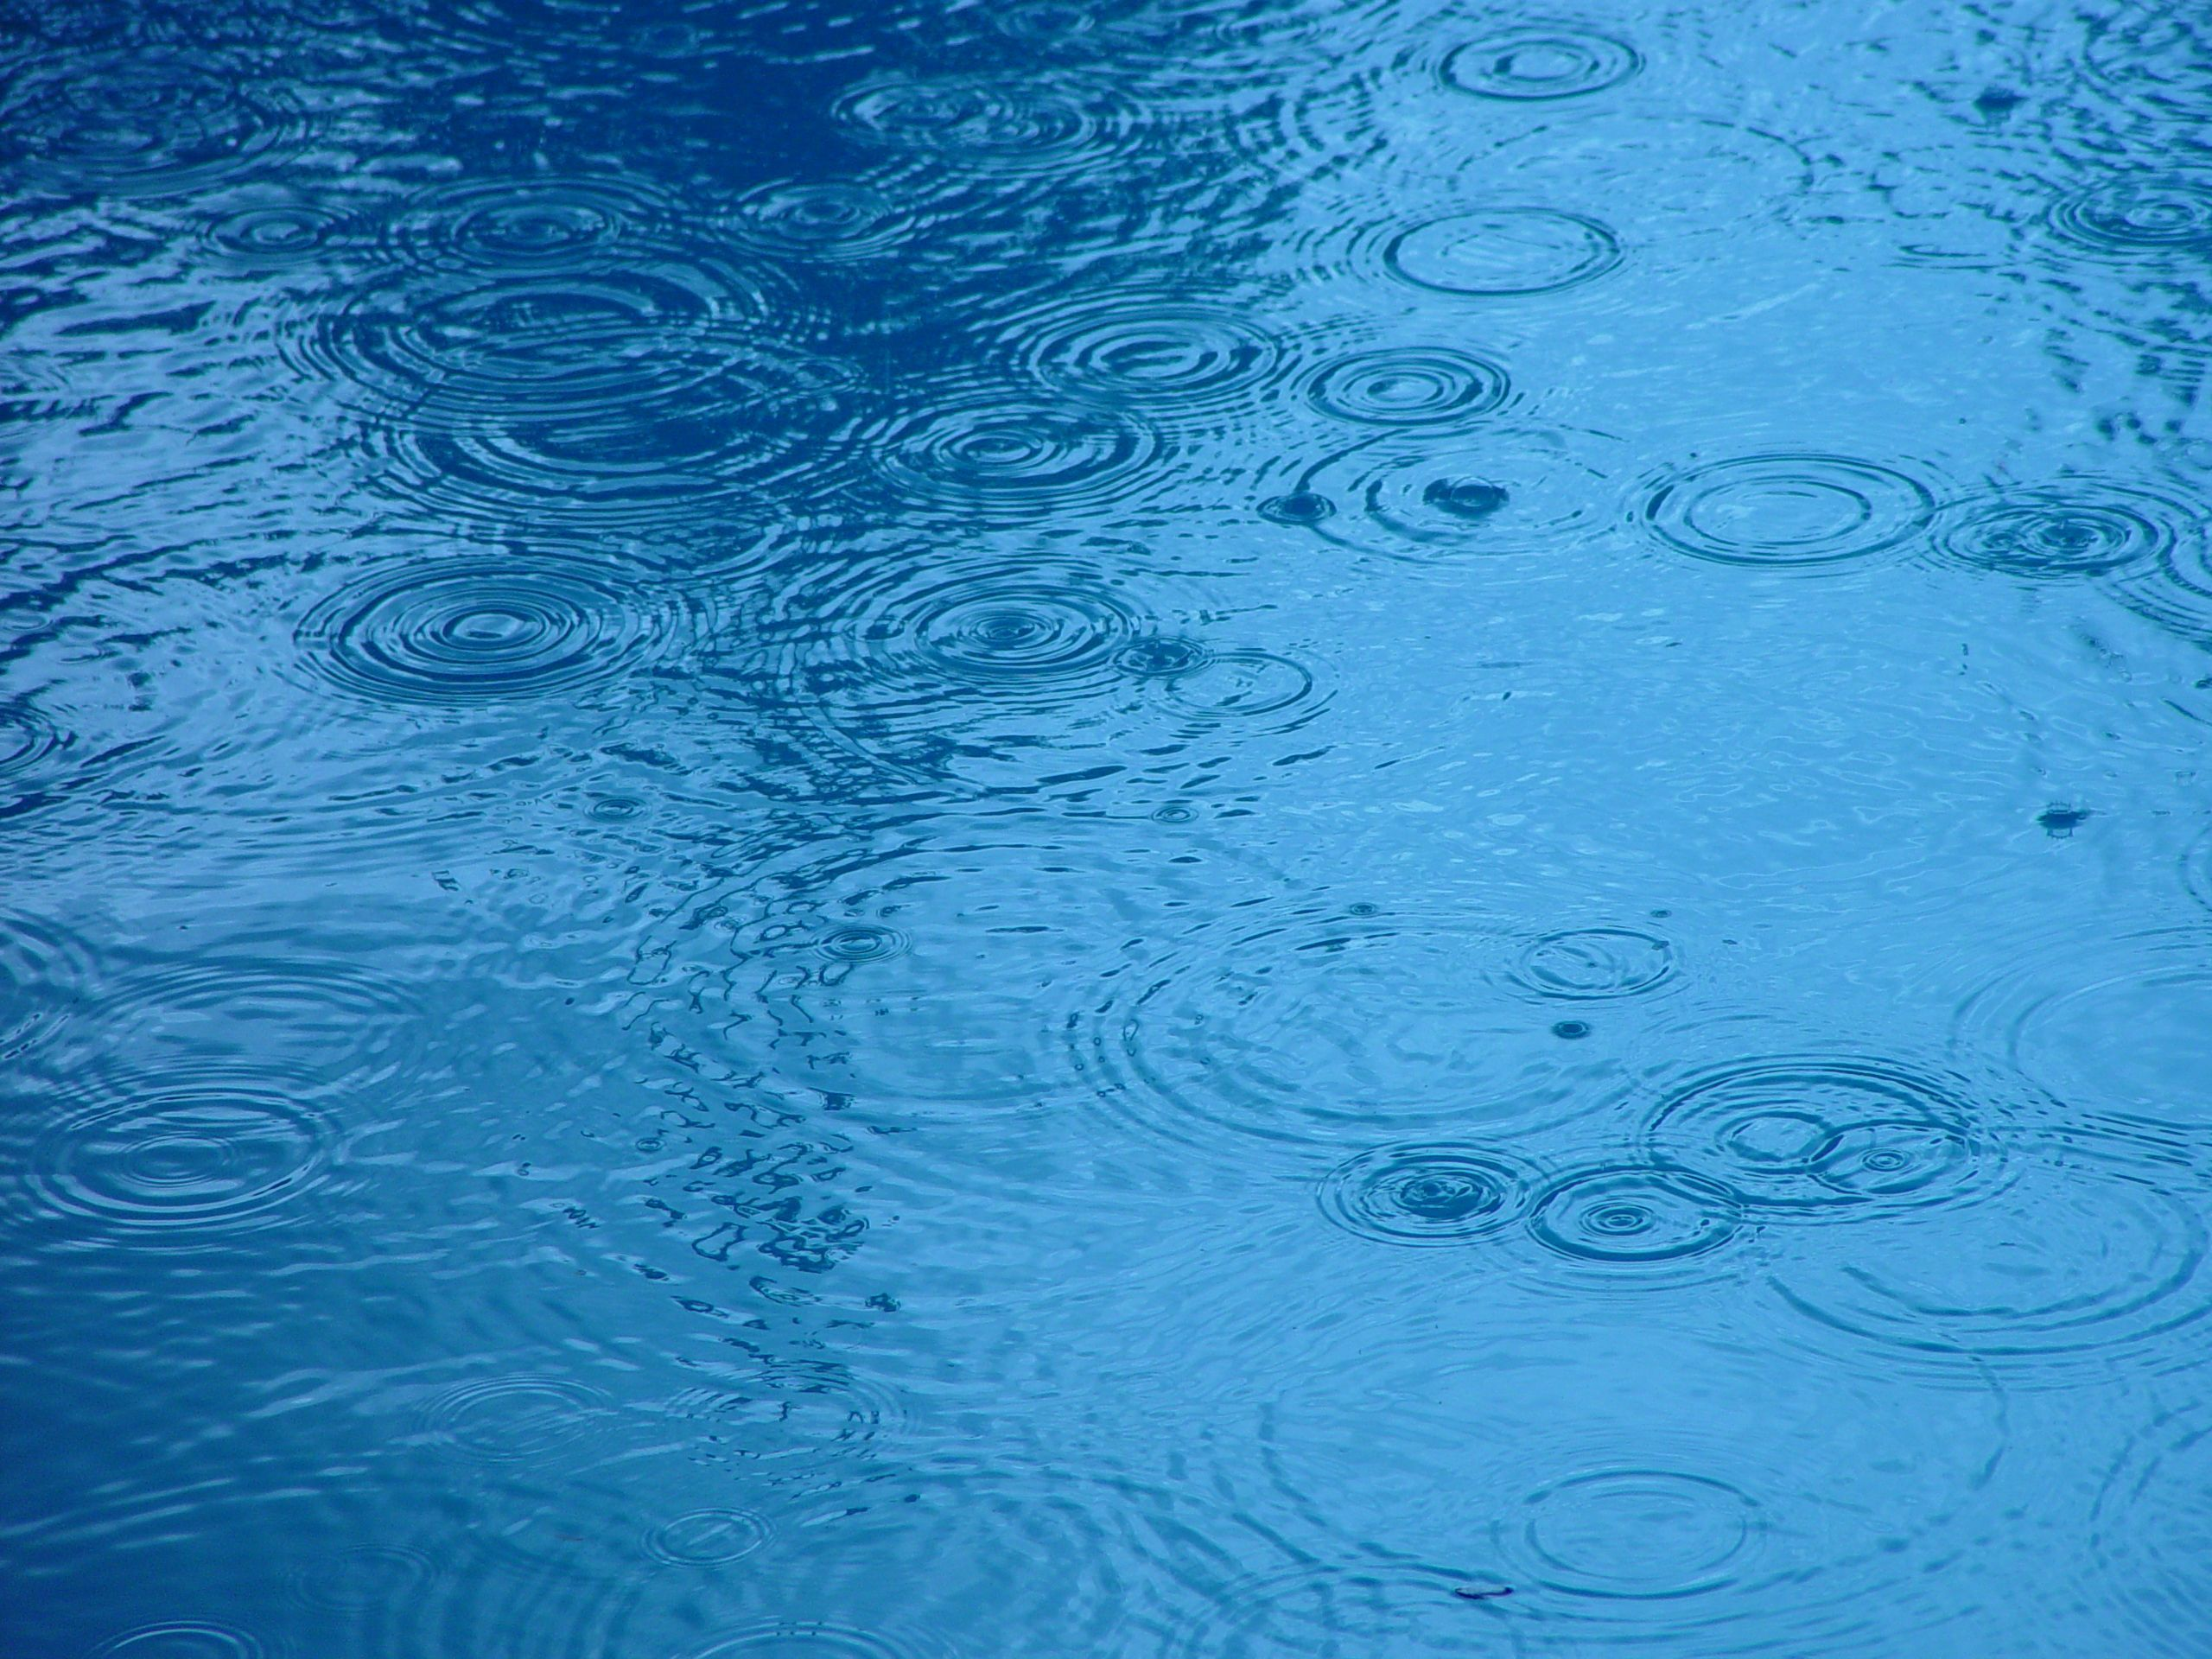

?
Considering what we know so far, where do you think daffodils flowered first?
2020-21 Weather Data: Ranked
Most Rain: 1 – Wales 2 – Scotland 3 – Northern Ireland 4 – England | Warmest: 1 – Wales 2 - England 3 – Northern Ireland 4 – Scotland

Slide 10

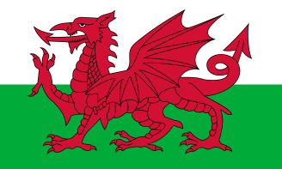



?
Where did the first daffodils flower?
1. Wales – 6th March
6
2. N. Ireland – 10th March
12
4
3
2
17
15
Click to start the animation and find out!
5
1
10
13
9
14
7
8
11
16
Plants require water and warm sunlight to grow, so daffodils grew more quickly where they had plenty of both.
However they can sometimes have too much water or sun, so this won’t always be true!
3. England – 11th March
4. Scotland – 17th March
Note: These are the average dates for bulbs in pots AND bulbs in the ground.
March
March
March
March
March
March
March
March
March
March
March
March
March
March
March
March
March
Daffodils flowered first in Wales!
Were you correct? Why do you think that is?
?

Slide 11






How many days difference was there between the daffodil flowering dates?
?
= bulbs planted in the ground
= bulbs planted in pots
= each box represents one day
Scotland
10 days
England
6 days
N. Ireland
Not Enough Data
Wales
12 days
1st March
8th March
15th March
22nd March
29th March
Average Flowering Date for Each Country

Slide 12

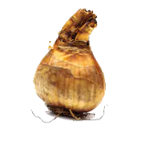
Our hypothesis was that daffodils in pots would flower before those in the ground.
We think this is because bulbs in the ground are more insulated, so they do not “feel” the changes in temperature as much.
This year daffodils in pots flowered first in every country except Scotland – which is the opposite of last year!
We would need to do more experiments to find out why. Do you have any ideas?

Slide 13
Here are the average flowering dates across the whole of the UK compared to last year:
 | 2020 | 2021
Daffodils in Pots | 7th March | 12th March
Daffodils in the Ground | 3rd March | 13th March
For both daffodils in pots and in the ground, the flowering date was later this year.
Although it is important to keep in mind that the lockdown restrictions might have affected the results. Schools may not have had access to their bulbs to report flowering dates all through February and March in 2020 or in 2021.

Slide 14
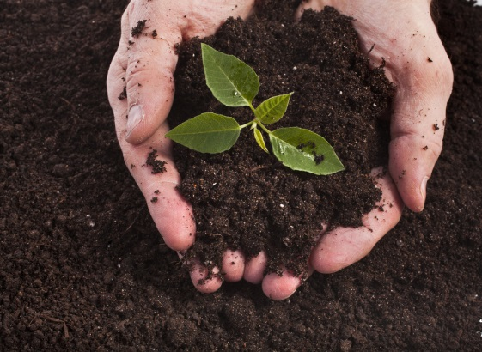
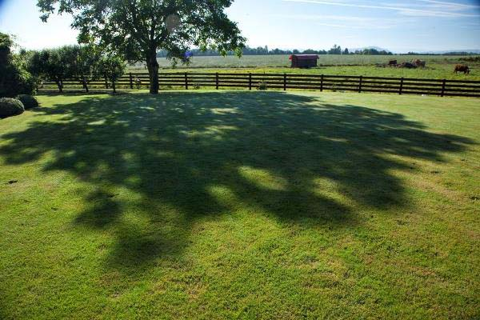
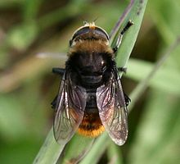
?
Do you think there could be other reasons for bulbs to flower earlier or later?
I’m not a bee! I’m a Narcissus Fly and I eat daffodil bulbs. I look like a bee so other animals think I can sting!
Here are some ideas of things that might affect daffodil flowering dates…
Soil quality
Shade
Pests & diseases
?
What changes could you make to the Bulb Project to test these ideas?

Slide 15
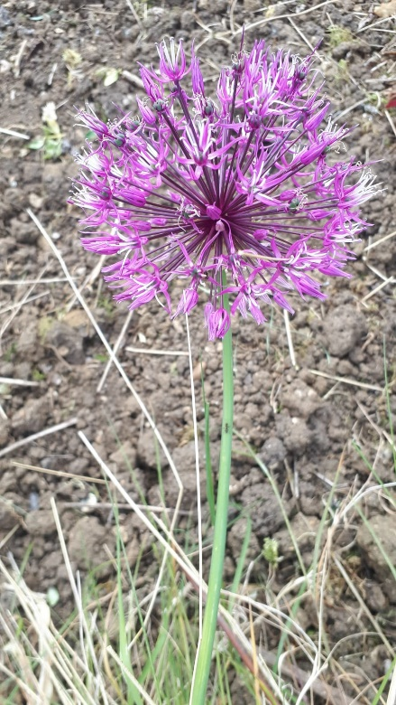
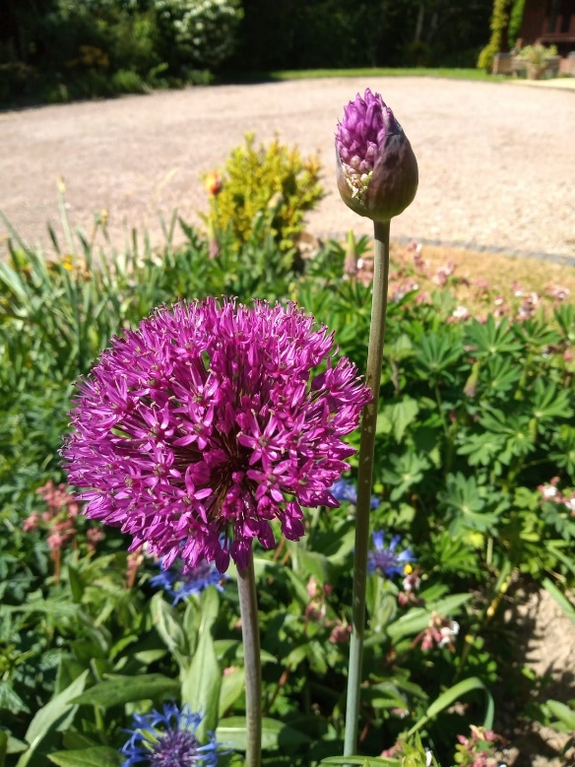
Mystery Bulbs!
Have your mystery bulbs flowered yet? In case they haven't, here are some photos of the same species of flower!
?
Can you find out what kind of flower this is?
Have you seen any growing in gardens or parks near your home?
?

Slide 16
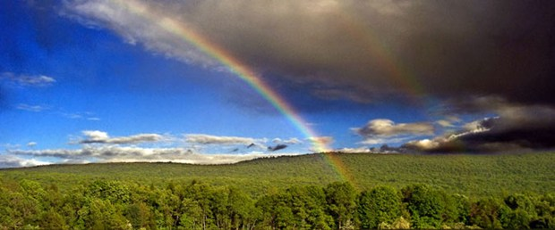
Finding a trend is quite difficult but some things are clear…
The bulbs rely on both warm sunshine and water in order to flower.
Our seasons are becoming more unpredictable as our world is getting warmer.
How do you think this will affect the growth of plants in the future?
?

