Slide 1


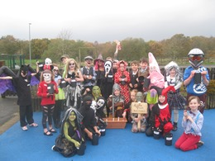
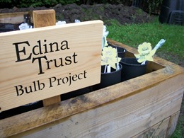
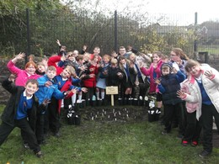
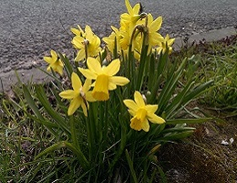
Results Report

Slide 2


Super Scientists!
The Edina Trust would like to thank everyone that worked so hard planting their bulbs, observing, and sending in their records.
We couldn’t have carried out an experiment like this without your help!
And now for the results…
Look out for questions along the way!
?

Slide 3
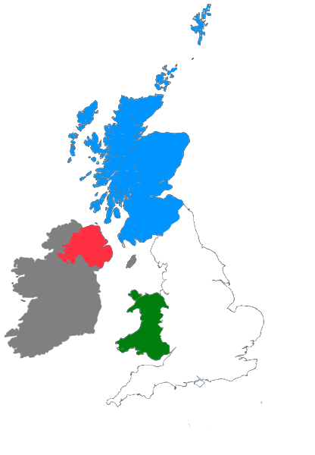
For this investigation we divided all schools into the four countries taking part:
Scotland: Dumfries & Galloway, East Ayrshire, Fife, Inverclyde, North Ayrshire, North Lanarkshire, Renfrewshire, South Lanarkshire, West Dunbartonshire
England: Lancashire, Lincolnshire, North East Lincolnshire, Oxfordshire, Sunderland, Wolverhampton
Northern Ireland: Belfast, Derry/Londonderry, Strabane
Wales: Conwy, Rhondda Cynon Taf

Slide 4


?
Which country had the most rain?
During the Bulb Project, Wales had an average of 76mm more rain per month – it’s about double the amount compared to England!
Wales had the most rain during the project.
Can you estimate how much more monthly rainfall there was in Wales than England?
?

Slide 5

?
Which country was the warmest/coldest?
Scotland is further north than England (it has a higher latitude). Places further from the equator do not have as much direct sunlight so it is normally colder.
Click here to watch the animation!
or click outside this box to skip
England was warmest, Scotland was coldest.
Why do you think that is? Why might Scotland have been the coldest area?
?

Slide 7
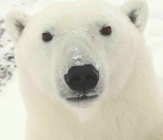
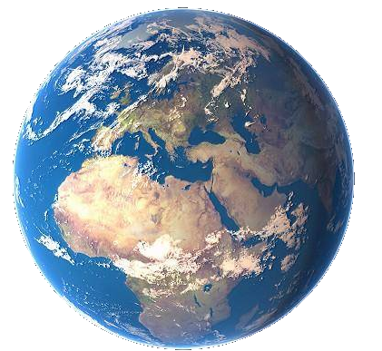
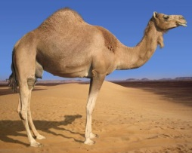

As the sunlight is shining on the Earth…
UK
This makes it warm at the equator and cold at the North and South Pole!
Equator
…the same amount of light and warmth is spread across more of the surface than at the equator.
Click here to replay!
or click outside this box to move on.

Slide 8
?
Which country was the warmest
in February?
Northern Ireland was the warmest region in February. England and Wales were very close too, compared to Scotland.

Slide 9
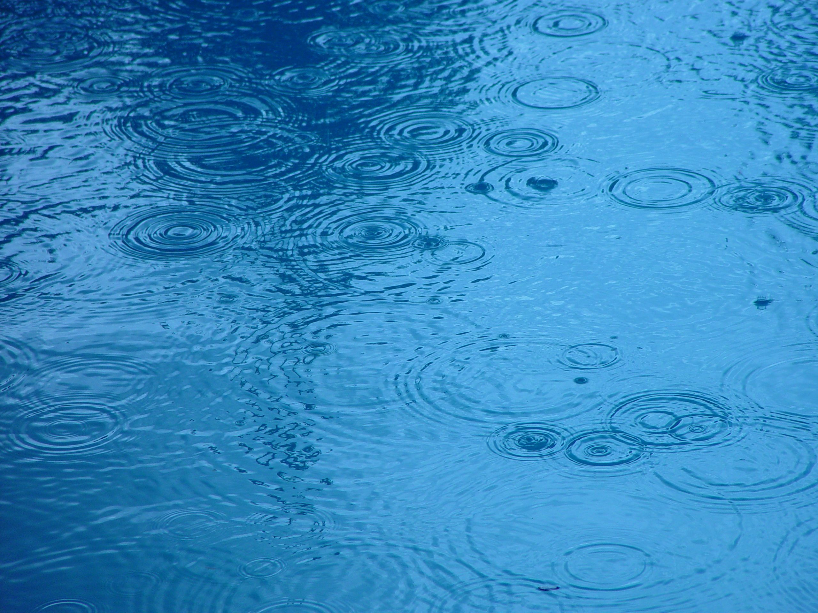

?
Considering what we know so far, where do you think daffodils flowered first?
Most Rain: 1 – Wales 2 – Scotland 3 – Northern Ireland 4 - England | Warmest: 1 – England 2 – Wales and Northern Ireland 3 - Scotland

Slide 10





?
Where did the first daffodils flower?
1. N. Ireland – 9th February
2. Wales – 27th February
11
1
26
7
10
9
9
6
7
8
19
27
2
28
6
1
4
14
17
8
23
22
3
5
20
25
11
12
2
3
10
13
5
21
15
24
4
16
18
Plants require water and warm sunlight to grow, so daffodils grew more quickly where they had plenty of both.
However they can sometimes have too much water or sun, so this won’t always be true!
Click to start the animation and find out!
3. England – 4th March
4. Scotland – 11th March
Note: These are the average dates for bulbs in pots AND bulbs in the ground.
March
March
February
March
February
February
March
March
February
February
February
February
March
February
February
February
February
February
February
March
February
February
March
March
February
February
February
February
February
February
March
February
February
February
February
February
March
February
February
Daffodils flowered first in Northern Ireland.
Were you correct? Why do you think that is?
?

Slide 11






How many days difference was there between the daffodil flowering dates?
?
= bulbs planted in the ground
= bulbs planted in pots
= each box represents one day
Scotland
4 days
England
1 day
N. Ireland
3 days
Wales
8 days
4th Feb
11th Feb
18th Feb
25th Feb
4th Mar
11th Mar
Average Flowering Date for Each Country

Slide 12

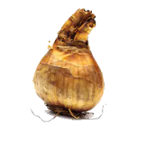
Our hypothesis was that daffodils in pots would flower before those in the ground.
This year that is what happened in all areas, but the dates were very close!
We think this is because bulbs in the ground are more insulated, so they do not “feel” the changes in temperature as much. But we would need to do more experiments to find out!

Slide 13
Here are the average flowering dates across the whole of the UK compared to last year:
 | 2018 | 2019
Daffodils in Pots | 22nd March | 27th February
Daffodils in the Ground | 12th March | 1st March
For both daffodils in pots and in the ground, the average flowering date is much earlier. For daffodils in pots, it’s nearly a whole month earlier!
Can you remember what the weather was like last year…?

Slide 14

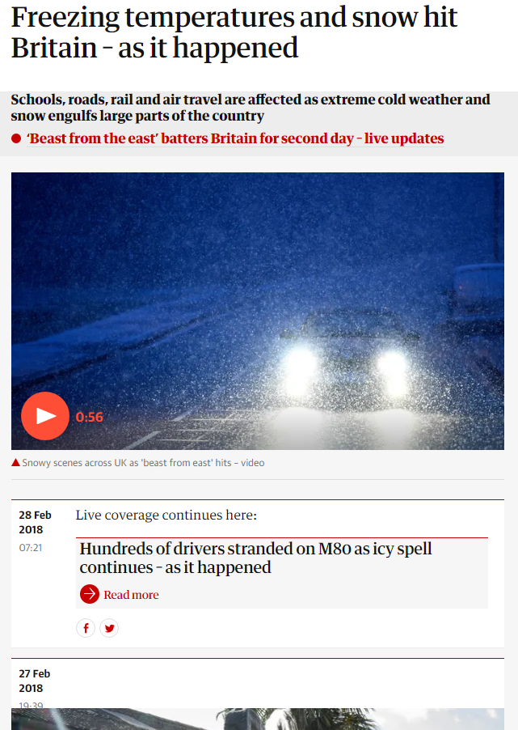

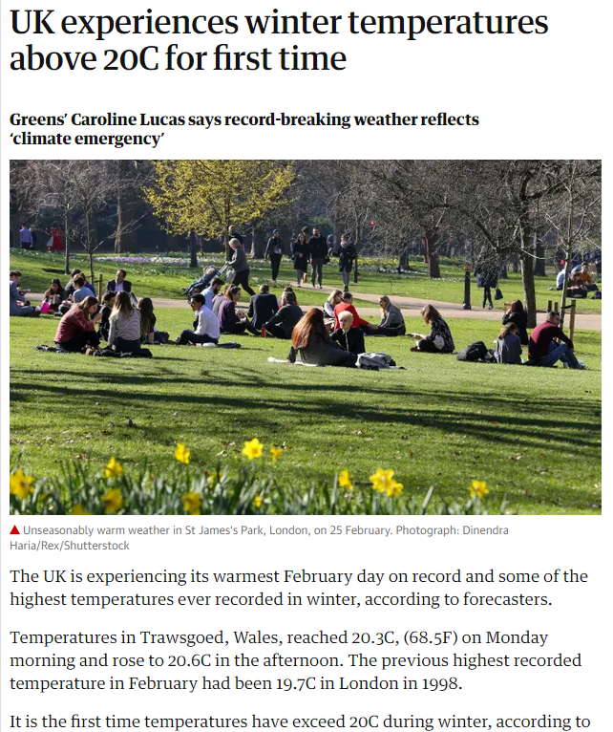
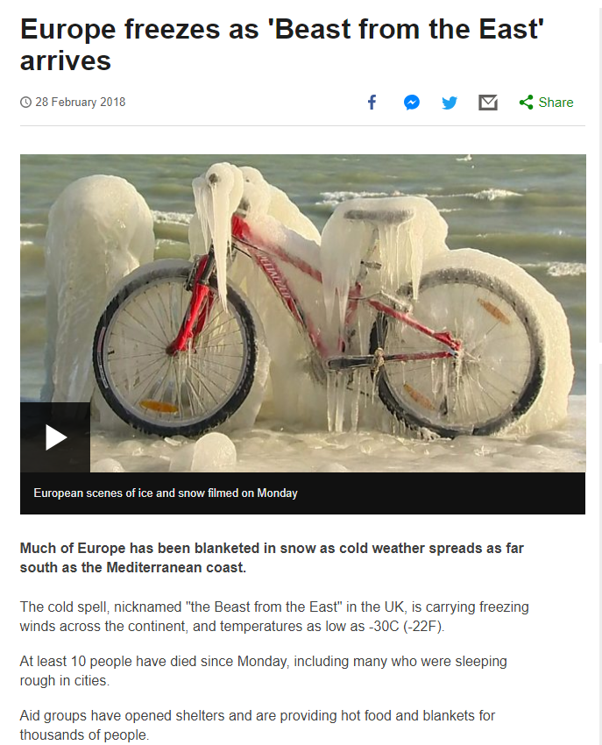
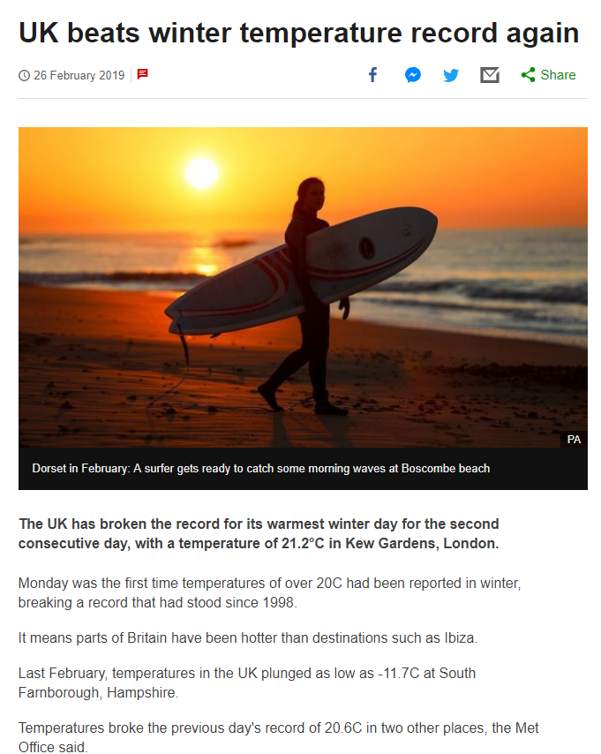
Spring 2018
Spring 2019
There was a big difference in the spring weather compared to last year! This is likely to be the reason for daffodils flowering earlier, due to the warmer temperatures, but…

Slide 15
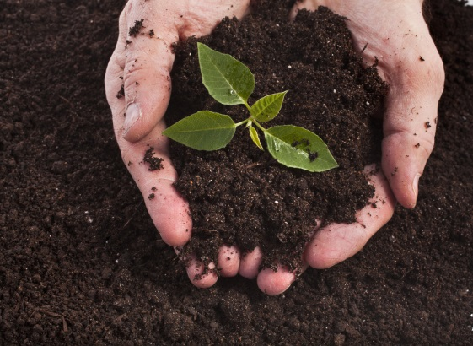
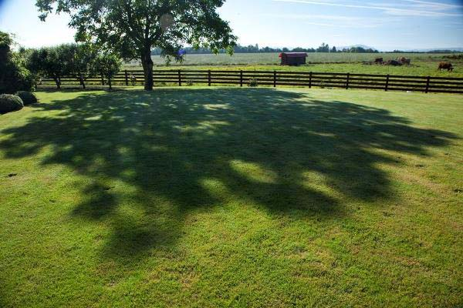
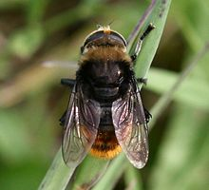
?
Do you think there could be other reasons for bulbs to flower earlier or later?
I’m not a bee! I’m a Narcissus Fly and I eat daffodil bulbs. I look like a bee so other animals think I can sting!
Here are some ideas of things that might affect daffodil flowering dates…
Soil quality
Shade
Pests & diseases
?
What changes could you make to the Bulb Project to test these ideas?

Slide 16
Which country had the tallest/shortest daffodils?
?
Average Height (cm)
27cm
26cm
24cm
Why do you think the daffodils grew the tallest in England?
About 9cm difference
18cm
?
Using the bar chart can you work out how tall the daffodils are?
How much taller were daffodils in England compared to Scotland?

Slide 17
On average, the daffodils were tallest in England.
England was the warmest area
England had the least rain
The warm sunshine could have helped the daffodils to grow tall.
Perhaps there were too many rainy days in other areas and the daffodils didn’t grow as tall.
To be sure why, we would need to do more experiments.
Can you think of any other reasons why daffodils grew taller in England?
?

Slide 18
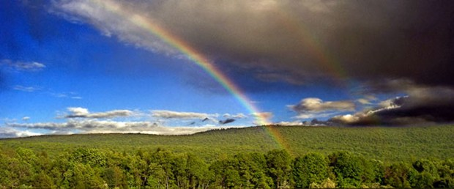
Finding a trend is quite difficult but some things are clear…
The bulbs rely on both warm sunshine and water in order to flower.
Our seasons are becoming more unpredictable as our world is getting warmer.
How do you think this will affect the growth of plants in the future?
?

